Slide 1

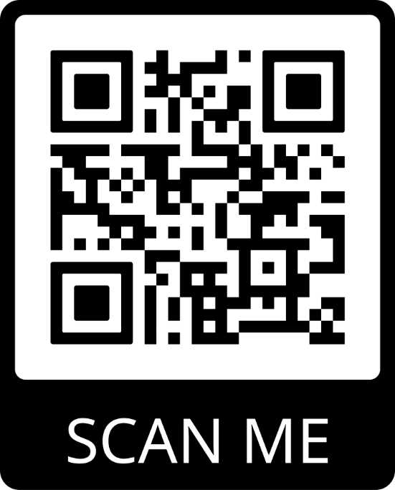



Doctoral School
of the University of Life Sciences in Lublin, Poland

Slide 2



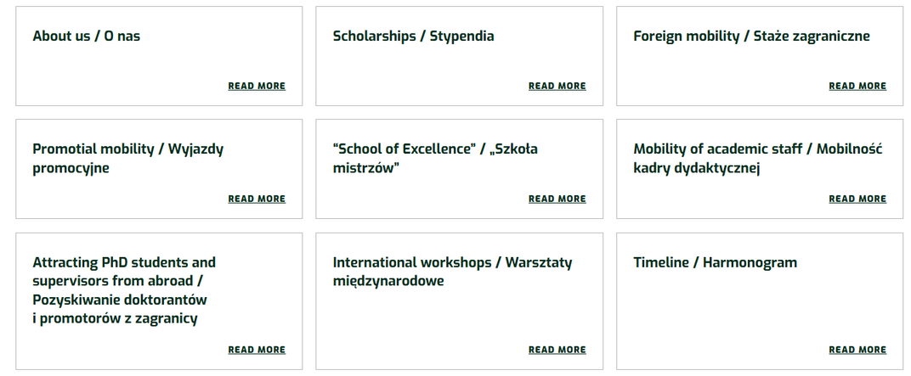
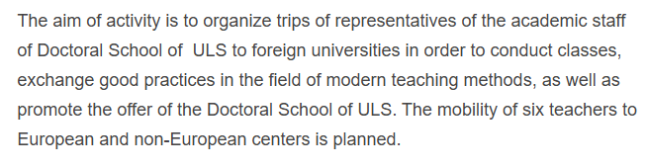
The main objective of the STER Program is to improve the quality of education in doctoral schools and the quality of research conducted by PhD students through systemic support for the internationalization process
2024-2026

Slide 3


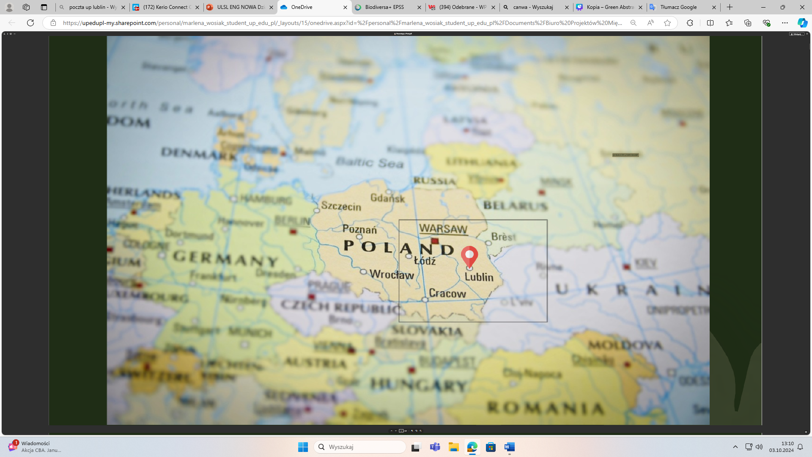

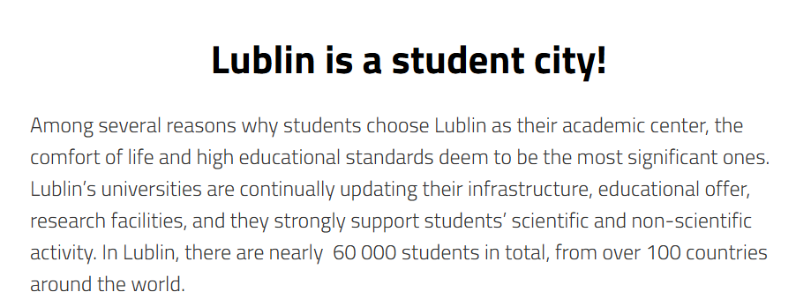
City of Lublin

Slide 4
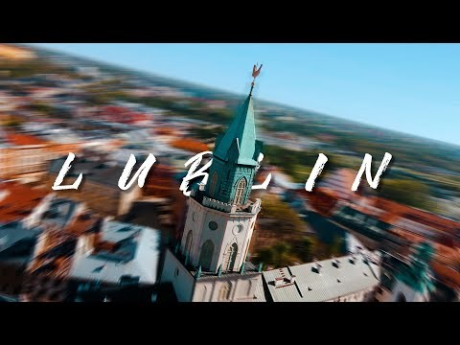
Lublin
promotional film
(2 minutes)
LUBLIN - Cinematic Travel Video

Slide 5


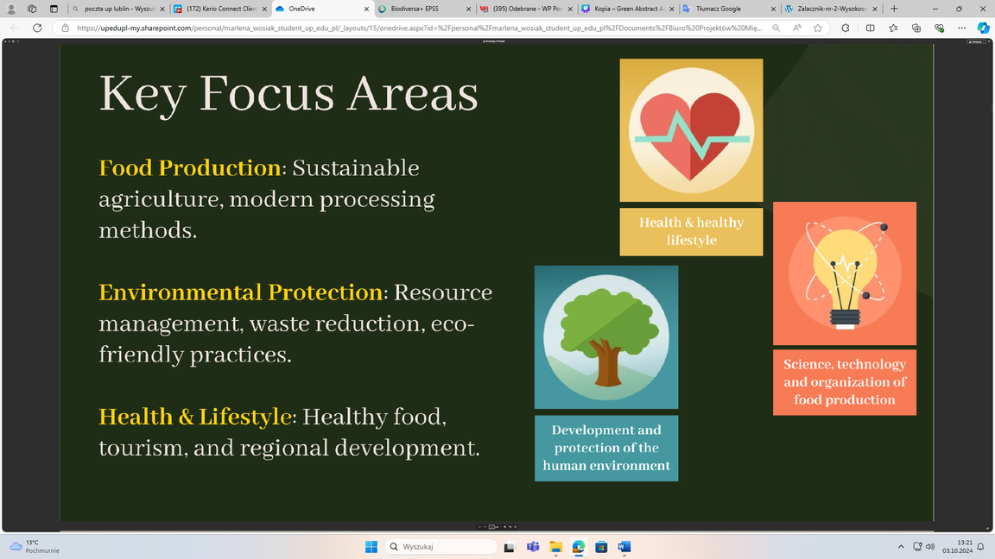
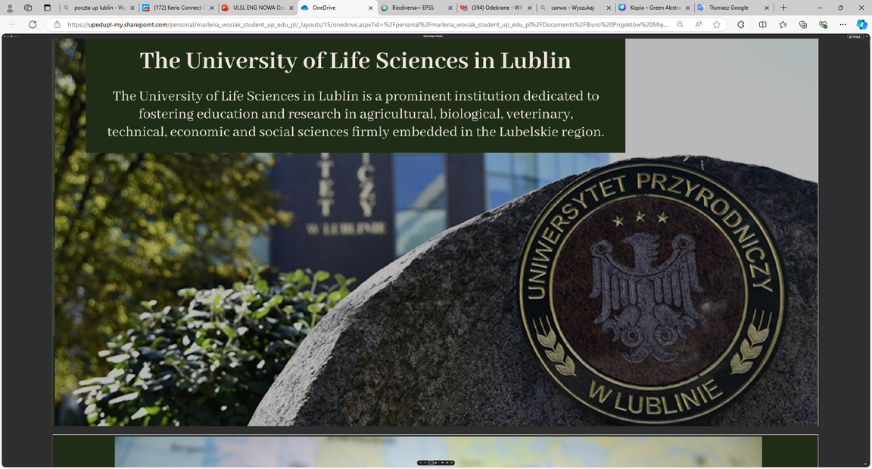
University of Life Sciences in Lublin (ULSL)

Slide 6
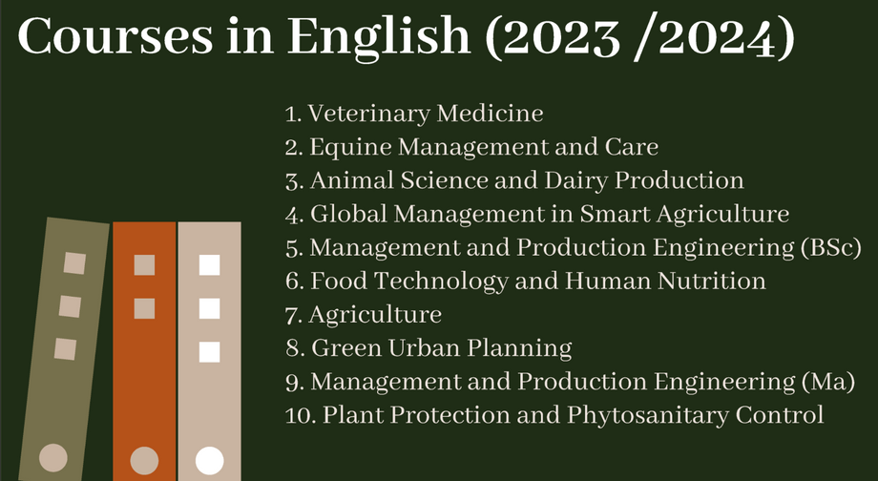

University of Life Sciences in Lublin (ULSL)

Slide 7
History
Doctoral
School of ULSL
Key data
Year of establishment 2019
11 Graduates
Present
85 PhD students including
  6 foreign students
  10 students realizing external projects
  16 implementation doctorate

Slide 8

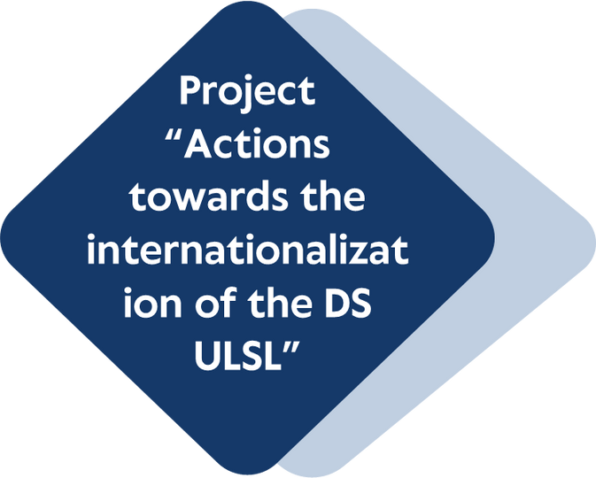
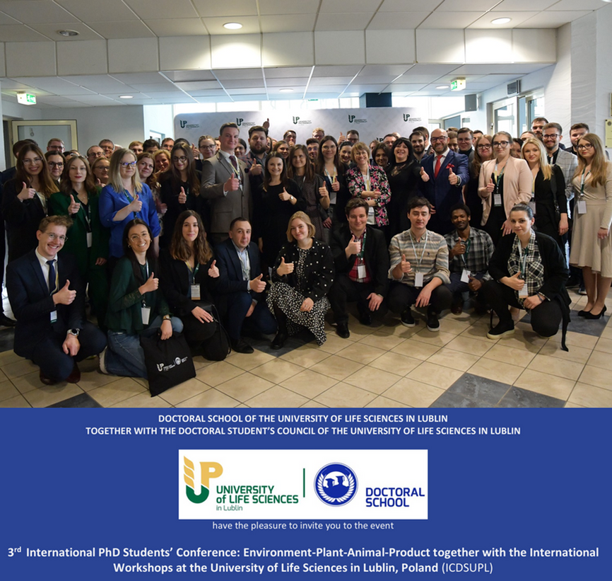
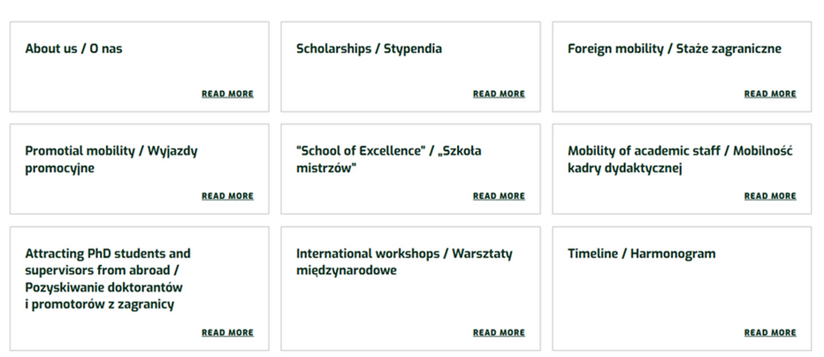
Our Activities
FUNDING: 1 985 410,00 PLN / approx. 460 000,00 EUR
IMPLEMENTATION PERIOD: 2024-01-01 – 2026-12-31

Slide 9
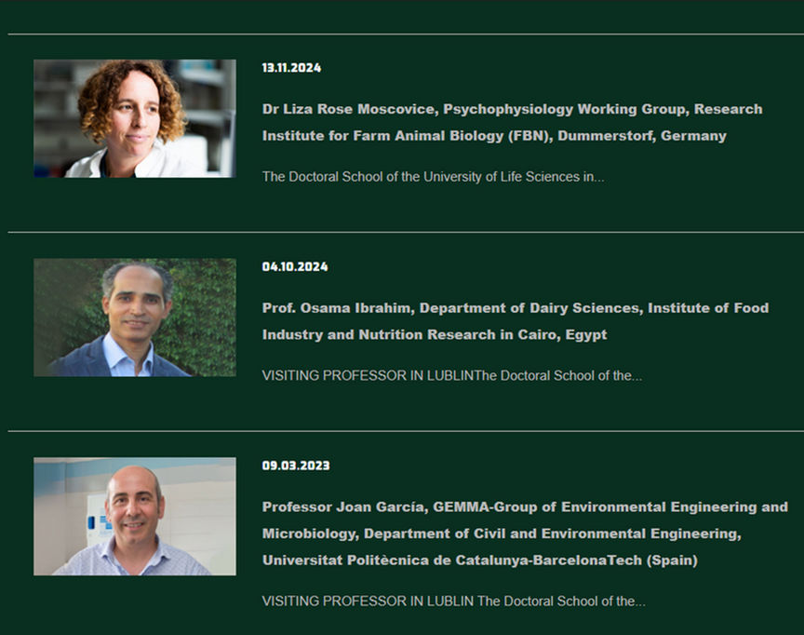
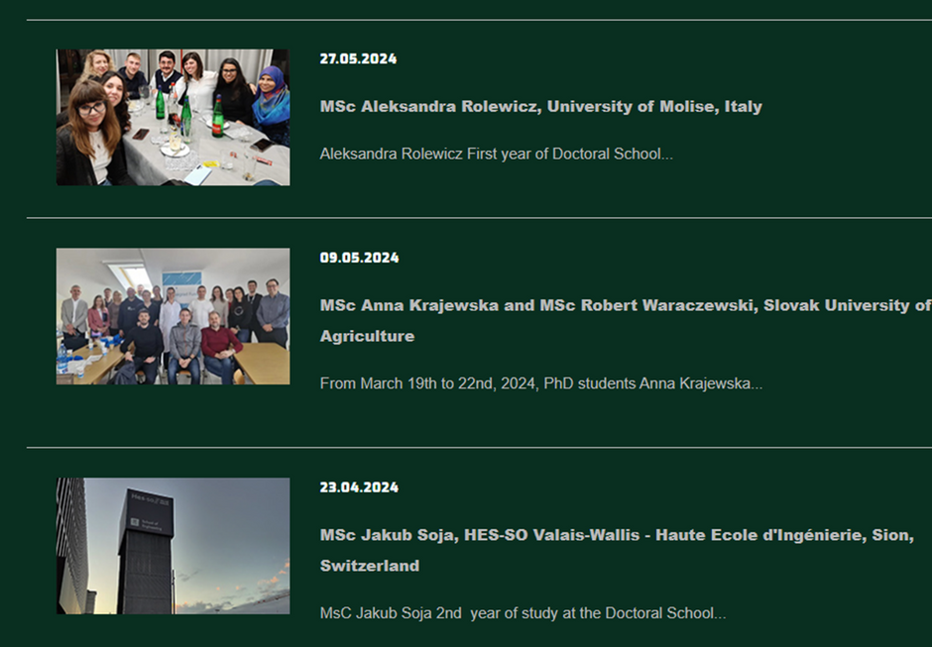
Our Activities
Visiting professors
from abroad
Long-term foreign mobilities
of PhD students

Slide 10
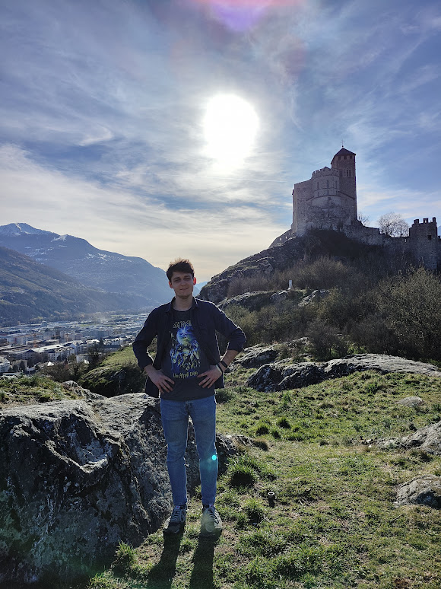
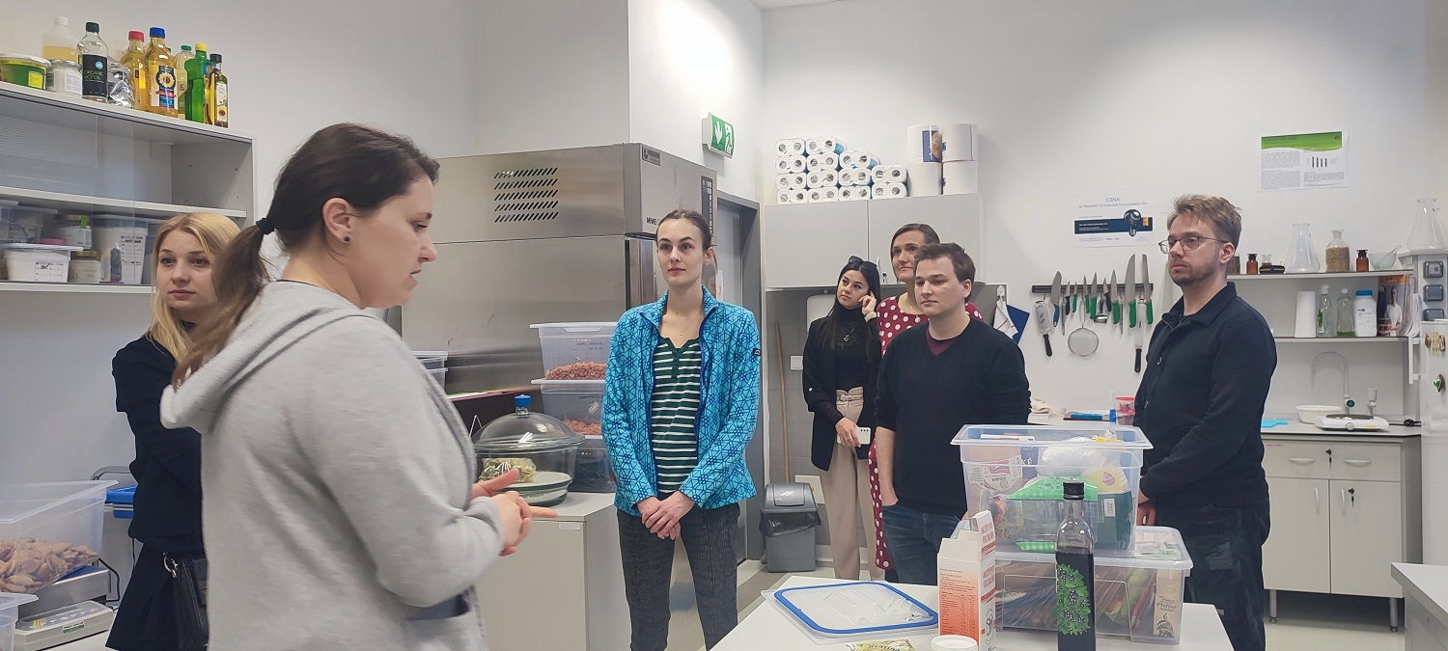
Our Activities
Austria​
  Medical University of Graz ​
  University of Natural Resources and Life Sciences
in Vienna ​
  University of Veterinary Medicine Vienna ​
Czech Republic​
  Charles University ​
  Czech University of Life Sciences Prague ​
  Mendel University in Brno ​
  Palacky University in Olomouc
Germany​
  Ansbach University of Applied Sciences ​
  Universitätsmedizin Greifswald ​
Hungary​
  Center for Agricultural Research, HUN-REN (Martonvásár)​
  Hungarian University of Agriculture and Life Sciences in Budapest ​
Ireland​
  University College Dublin ​
Italy​
  University of Molise (Università degli Studi del Molise) ​
  University of Parma
Spain​
  Centro Tecnológico de la Carne de Galicia ​
  Instituto de Investigación Biomédica, A Coruña ​
  University of Valencia
  Universitat Politècnica de Catalunya-BarcelonaTech UPC ​
Sweden​
  Swedish University of Agricultural Sciences ​
​ Switzerland​
  HES-SO Valais-Wallis – Haute Ecole d’Ingénierie
​​Turkey​
  Istanbul University-Cerrahpasa, Istanbul
Slovakia​
  Slovak University of Agriculture​
Slovenia​
  Agricultural Institute of Slovenia in Ljubljana​
​USA​
  UC Davis, USA ​
Lithuania​
  Lithuanian University of Health Sciences
Netherlands​
  Wageningen University & Research ​
Portugal​
  Universidade de Aveiro​
Serbia​
  University of Belgrade
Long-term foreign mobilities of PhD students

Slide 11
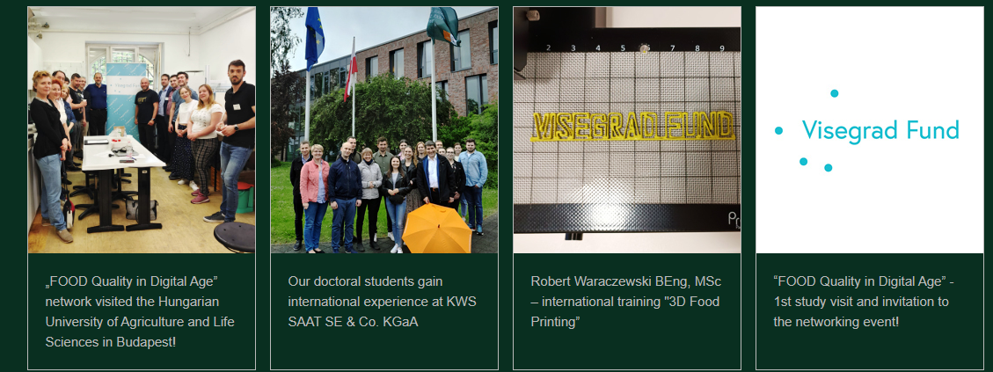

Our Activities
Study visits to foreign research centers
Seminars
and workshops conducted by foreign researchers

Slide 12

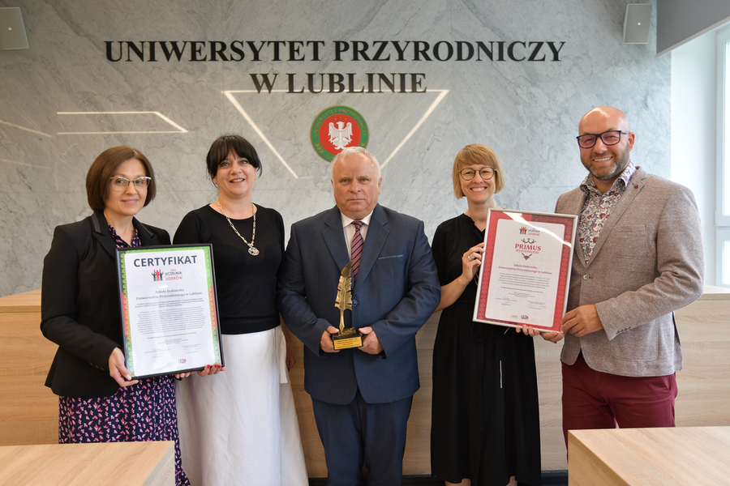

Our Achievments
"University of Leaders 2024" certificate
"University of Leaders 2023" certificate and the "Primus" Extraordinary Distinction
The Most Pro-doctoral University in the PRODOK 2023 National Competition
The Most Pro-doctoral University in the PRODOK 2021 National Competition

Slide 13



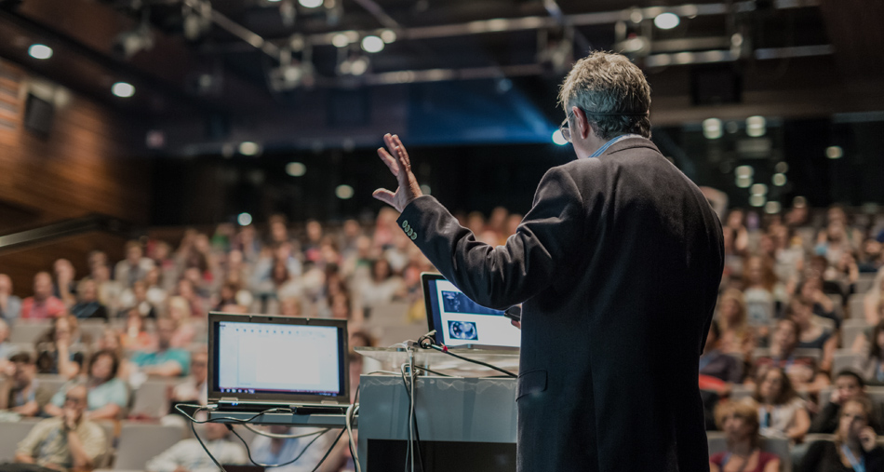
Our Offer
PhD students candidates
PhD students
Researchers and teachers

Slide 14

4 years programme
(8 semesters)
Interdisciplinary
educational programme
(Polish and English groups)
Specialised education
in given research discipline(s)
PhD students
candidates
Educational structure
Obligatory subjects
e.g. Seminars, Methodology of science, Preparation of projects, Commercialisation
(60-15 hours per semester)
Professional training
e.g. clasess with students, trainings in veterinary clinics / food technology laboratories
(30 hours per semester)
Implementation of individual research plans in departments together with supervisor(s)
Participation in conferences, workshops, abroad internships

Slide 15












Agriculture and horticulture
Veterinary medicine
PhD students
candidates
Food technology and human nutrition
Animal sciences and fisheries
Research disciplines
Biological sciences
Environmental engineering, mining and power engineering
Mechanical engineering

Slide 16
PhD students
candidates
Interdisciplinary PhD disertation

Slide 17
4-years scholarship for 14 accepted candidates funded by the Rector (accomodation and food expenses) (800-1500 EUR PM)
PhD students
candidates
2-years research grant for all applying PhD students (equipment, materials, conferences, open access) (2000-2500 EUR PY)
Free participation in stationary conferences, workshops, seminars and foreign study visits organized by the Doctoral School of ULSL
Financial terms
Long-term mobility grants (2500 EUR PM + travel expenses)

Slide 18
Prepare and implement the Individual Research Plan together with the supervisor(s);
Participate stationary or in on-line format in education process (English and Polish gropus);
PhD students
candidates
Conduct or co-conduct classes with students (in English or Polish);
Obligations
Participate in conferences, workshops, lectures and other additional stationary and on-line events organized by the Doctoral School of ULS;
Complete a mandatory 3-month internship abroad
Submit research project to obtain funding from external sources

Slide 19
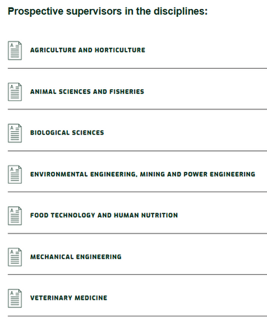
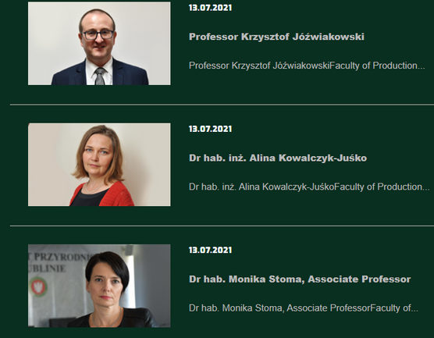
Select scientific discipline(s)
Find the prospective supervisor from ULSL
PhD students
candidates
Prepare Description of research plan
Submit documents via on-line registration system
How to apply
Participate in on-line recruitments interviews

Slide 20
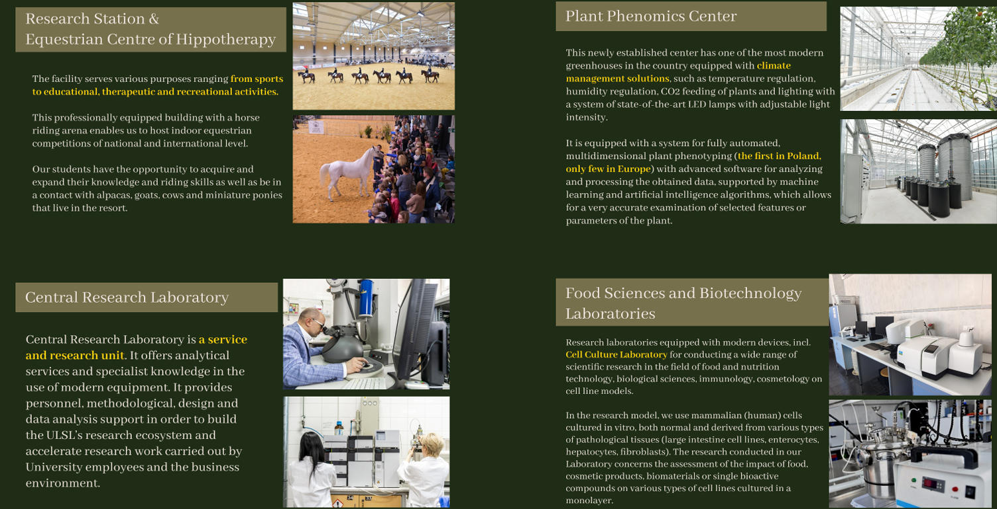
Didactic mobility as a part of ERASMUS+ programme
Research mobility aimed at conducting research using the ULSL infrastructure and with the help of ULSL employees
Offer for
PhD students

Slide 21
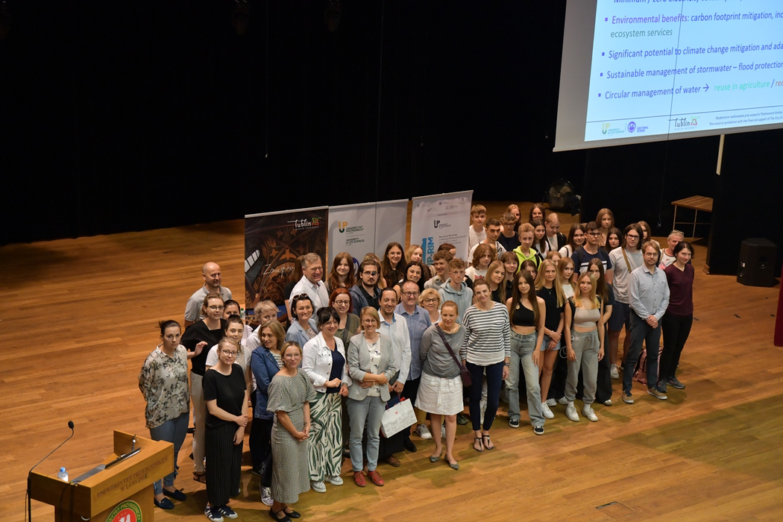
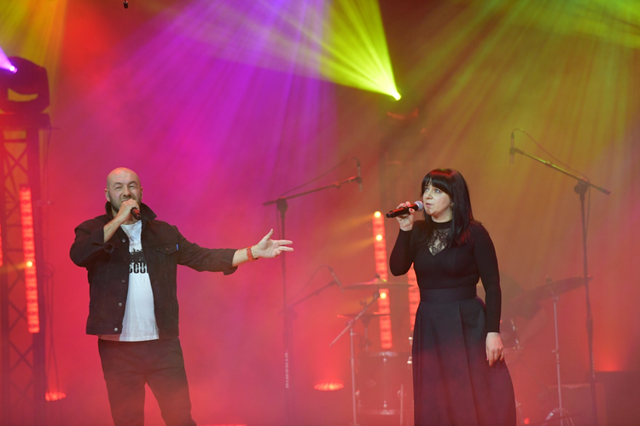
Participation in yearly organized International PhD student conference (stationary or on-line); Mobility grants from ULSL for incoming PhD students
Offer for
Participation in yearly organized PhD students seminars (on-line)
PhD students
Vice-Rector for Science and International Cooperation
Director of ULSL Doctoral School

Slide 22
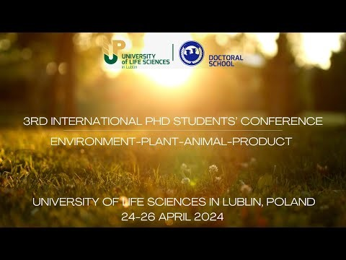
International
PhD students
conference
(1 minute)
3rd International PhD Students’ Conference: Environment-Plant-Animal-Product together with the International Workshops at the University of Life Sciences in Lublin, Poland

Slide 23
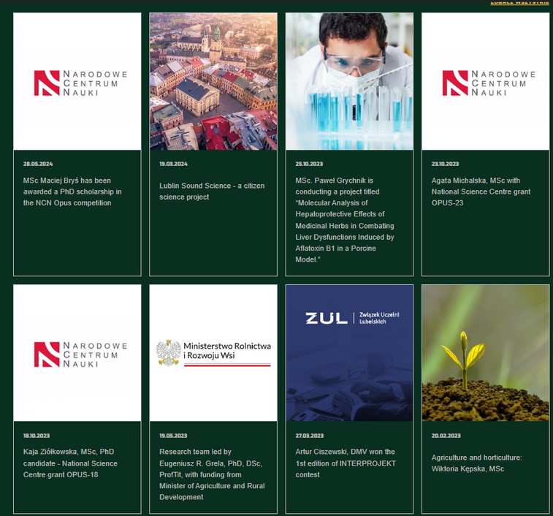
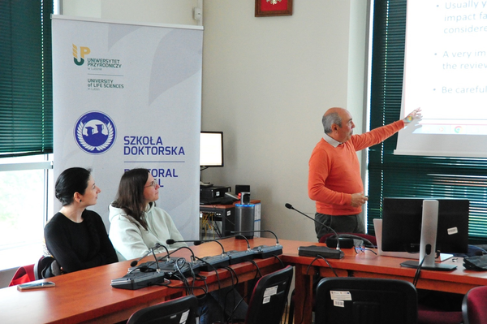
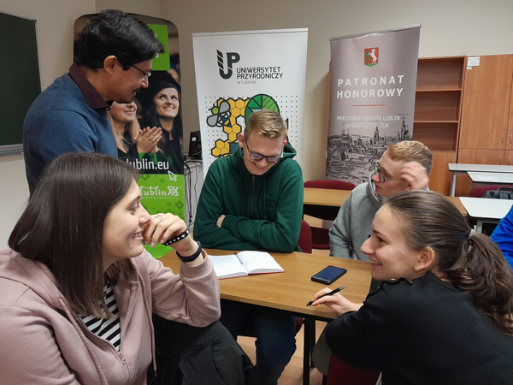
Co-supervision of PhD projects; One-time remuneration after completing the doctoral defense
Teaching activities as a “Visiting Professor” financed by diffrent ULSL and Lublin city programs (stationary/blended mobility; monthly/weekly)
Offer for
Researchers and teachers

Slide 24
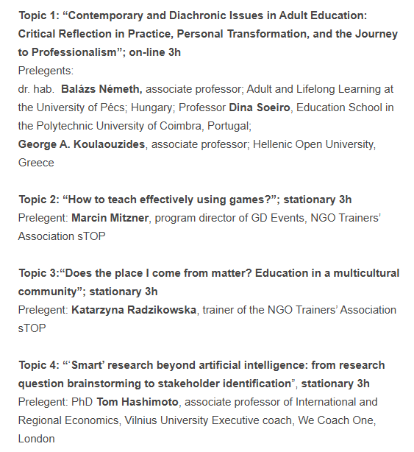

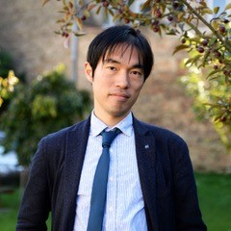
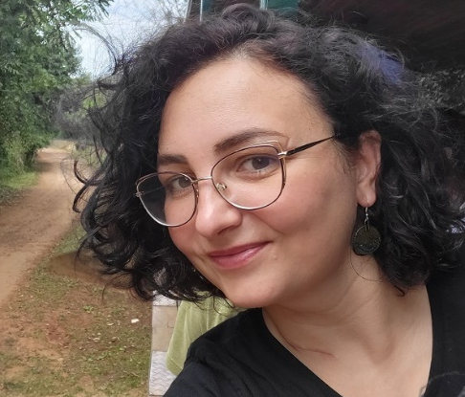
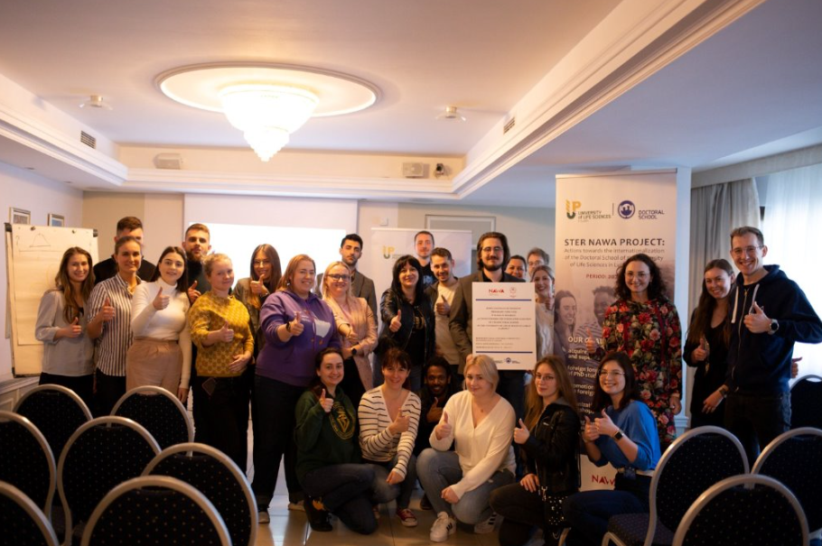
Conducting workshops on soft skills directed to PhD student; Mobility grants +remuneration financed by STER project (stationary/on-line)
Offer for
Researchers and teachers

Slide 25
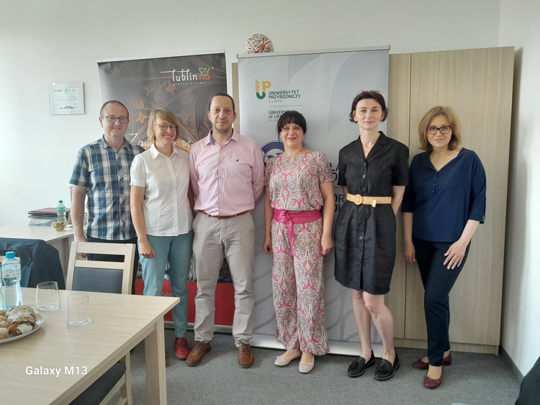
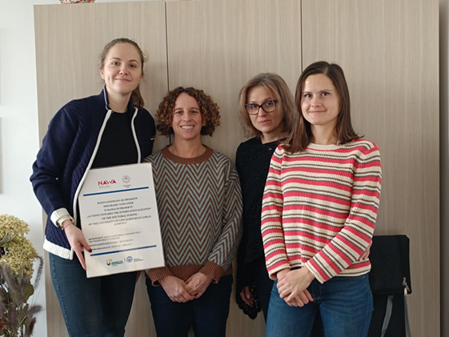
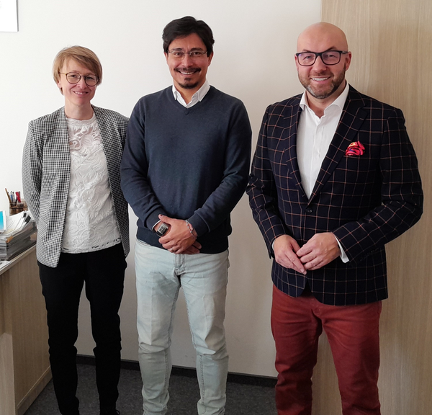
Offer for
Study visits to the doctoral school of ULSL in order to exchange good practices in PhD students education and school management
Researchers and teachers

Slide 26

Doctoral School
promotional film
(10 minutes)
Promotional content / Materiały promocyjne | NAWA STER

Slide 27
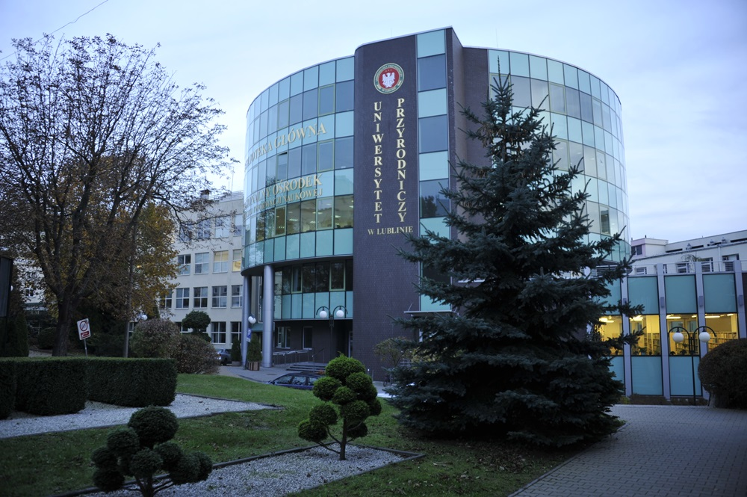
Connect with us.
Email
szkola.doktorska@up.lublin.pl
Web page
https://up.lublin.pl/en/doctoral-school/
If you are interested in cooperation, please contact me after the presentation

