Slide 1
ERASMUS ROK 2023/24
HANNOVER
Klaudia Brzęk Julia Antończyk

Slide 2
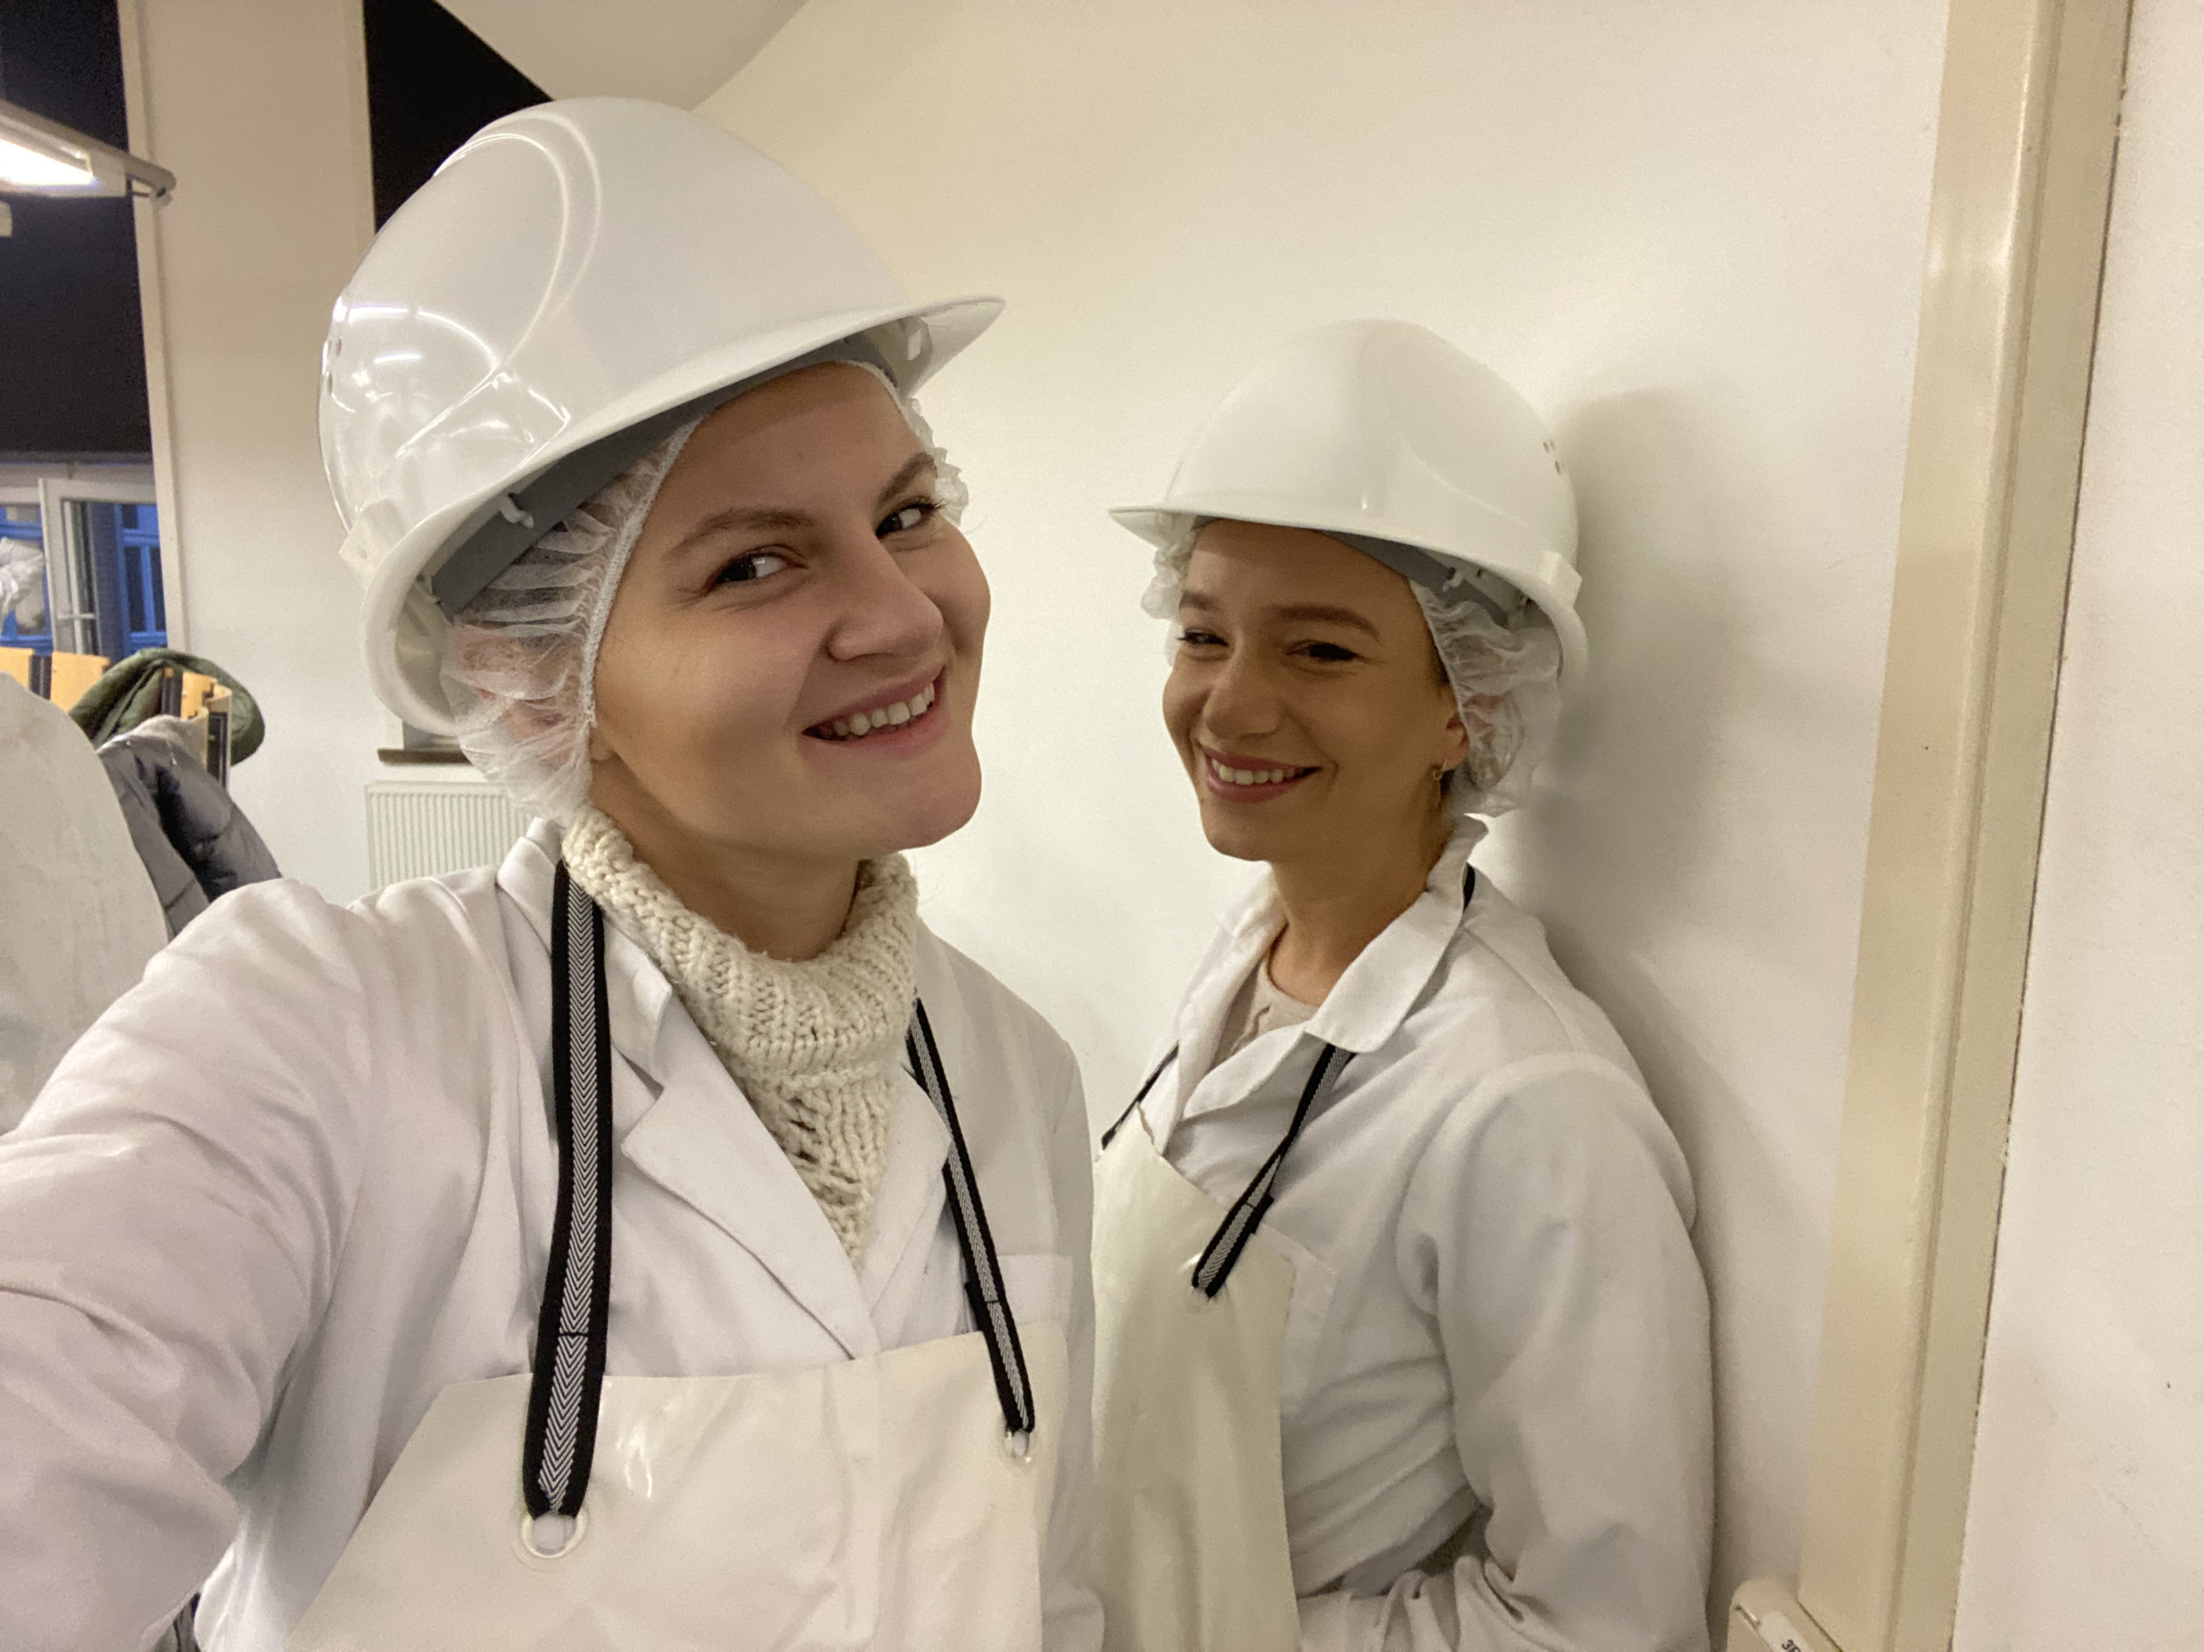
HANNOVER – capital of lower saxony
We often compare Hanover in Germany to Lublin in Poland. It is a large city, but also a green city. You can also meet a lot of students from all over the world here.

Slide 3
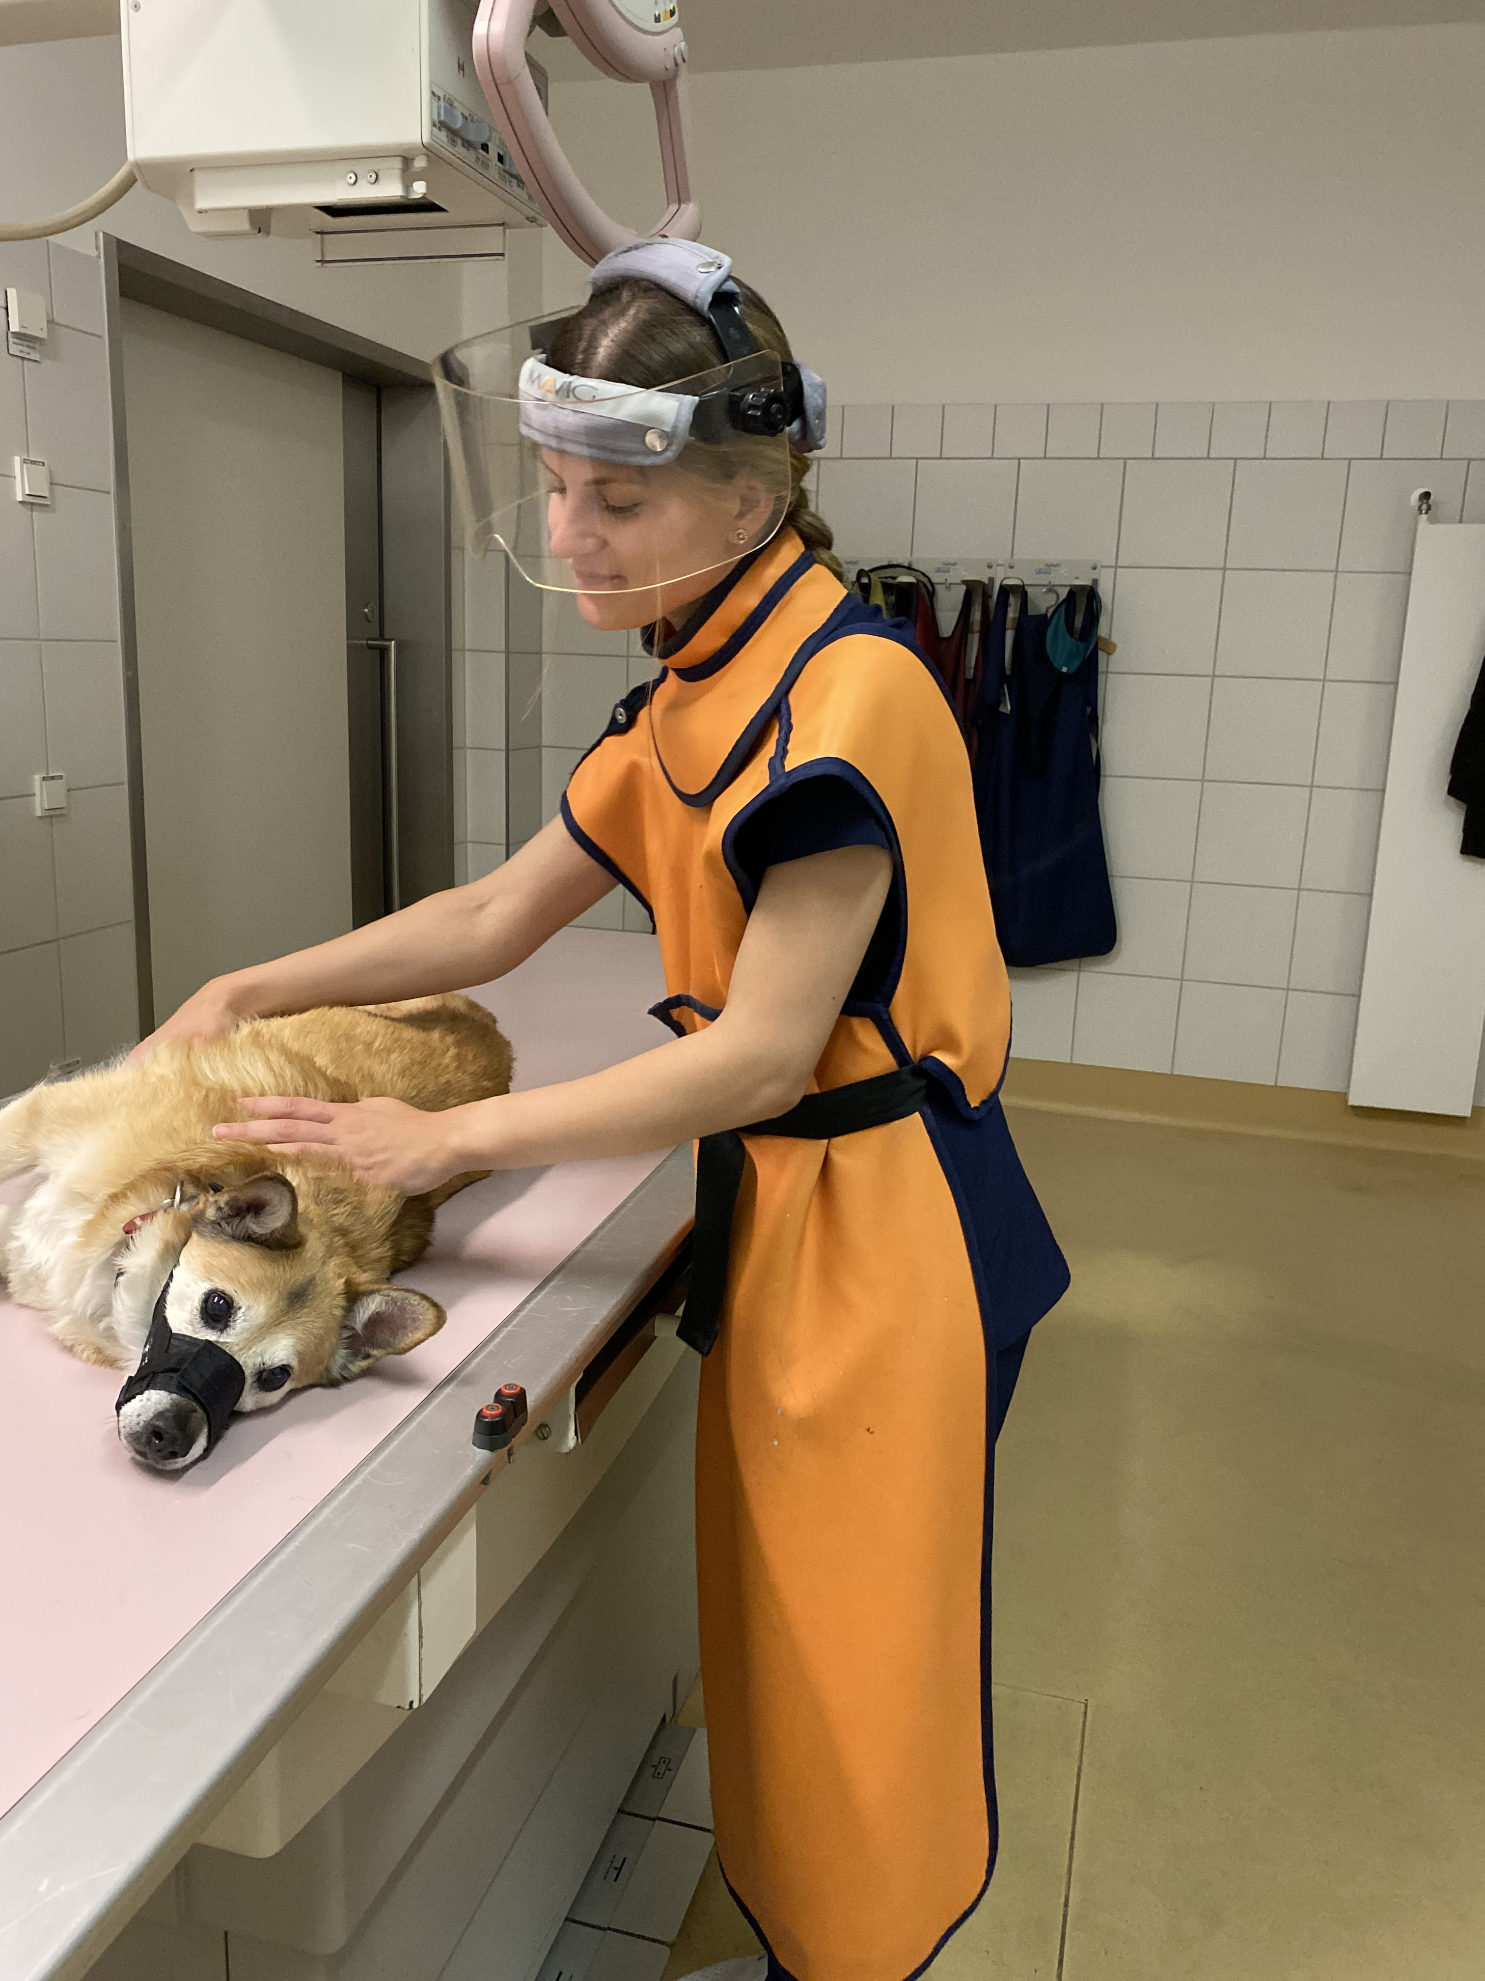
HANNOVER - clinics
You can participate in mitlaufen - which is a class where you help the doctors in their work. You can assist in the clinic for small animals, exotics, horses, cows and small ruminants

Slide 4
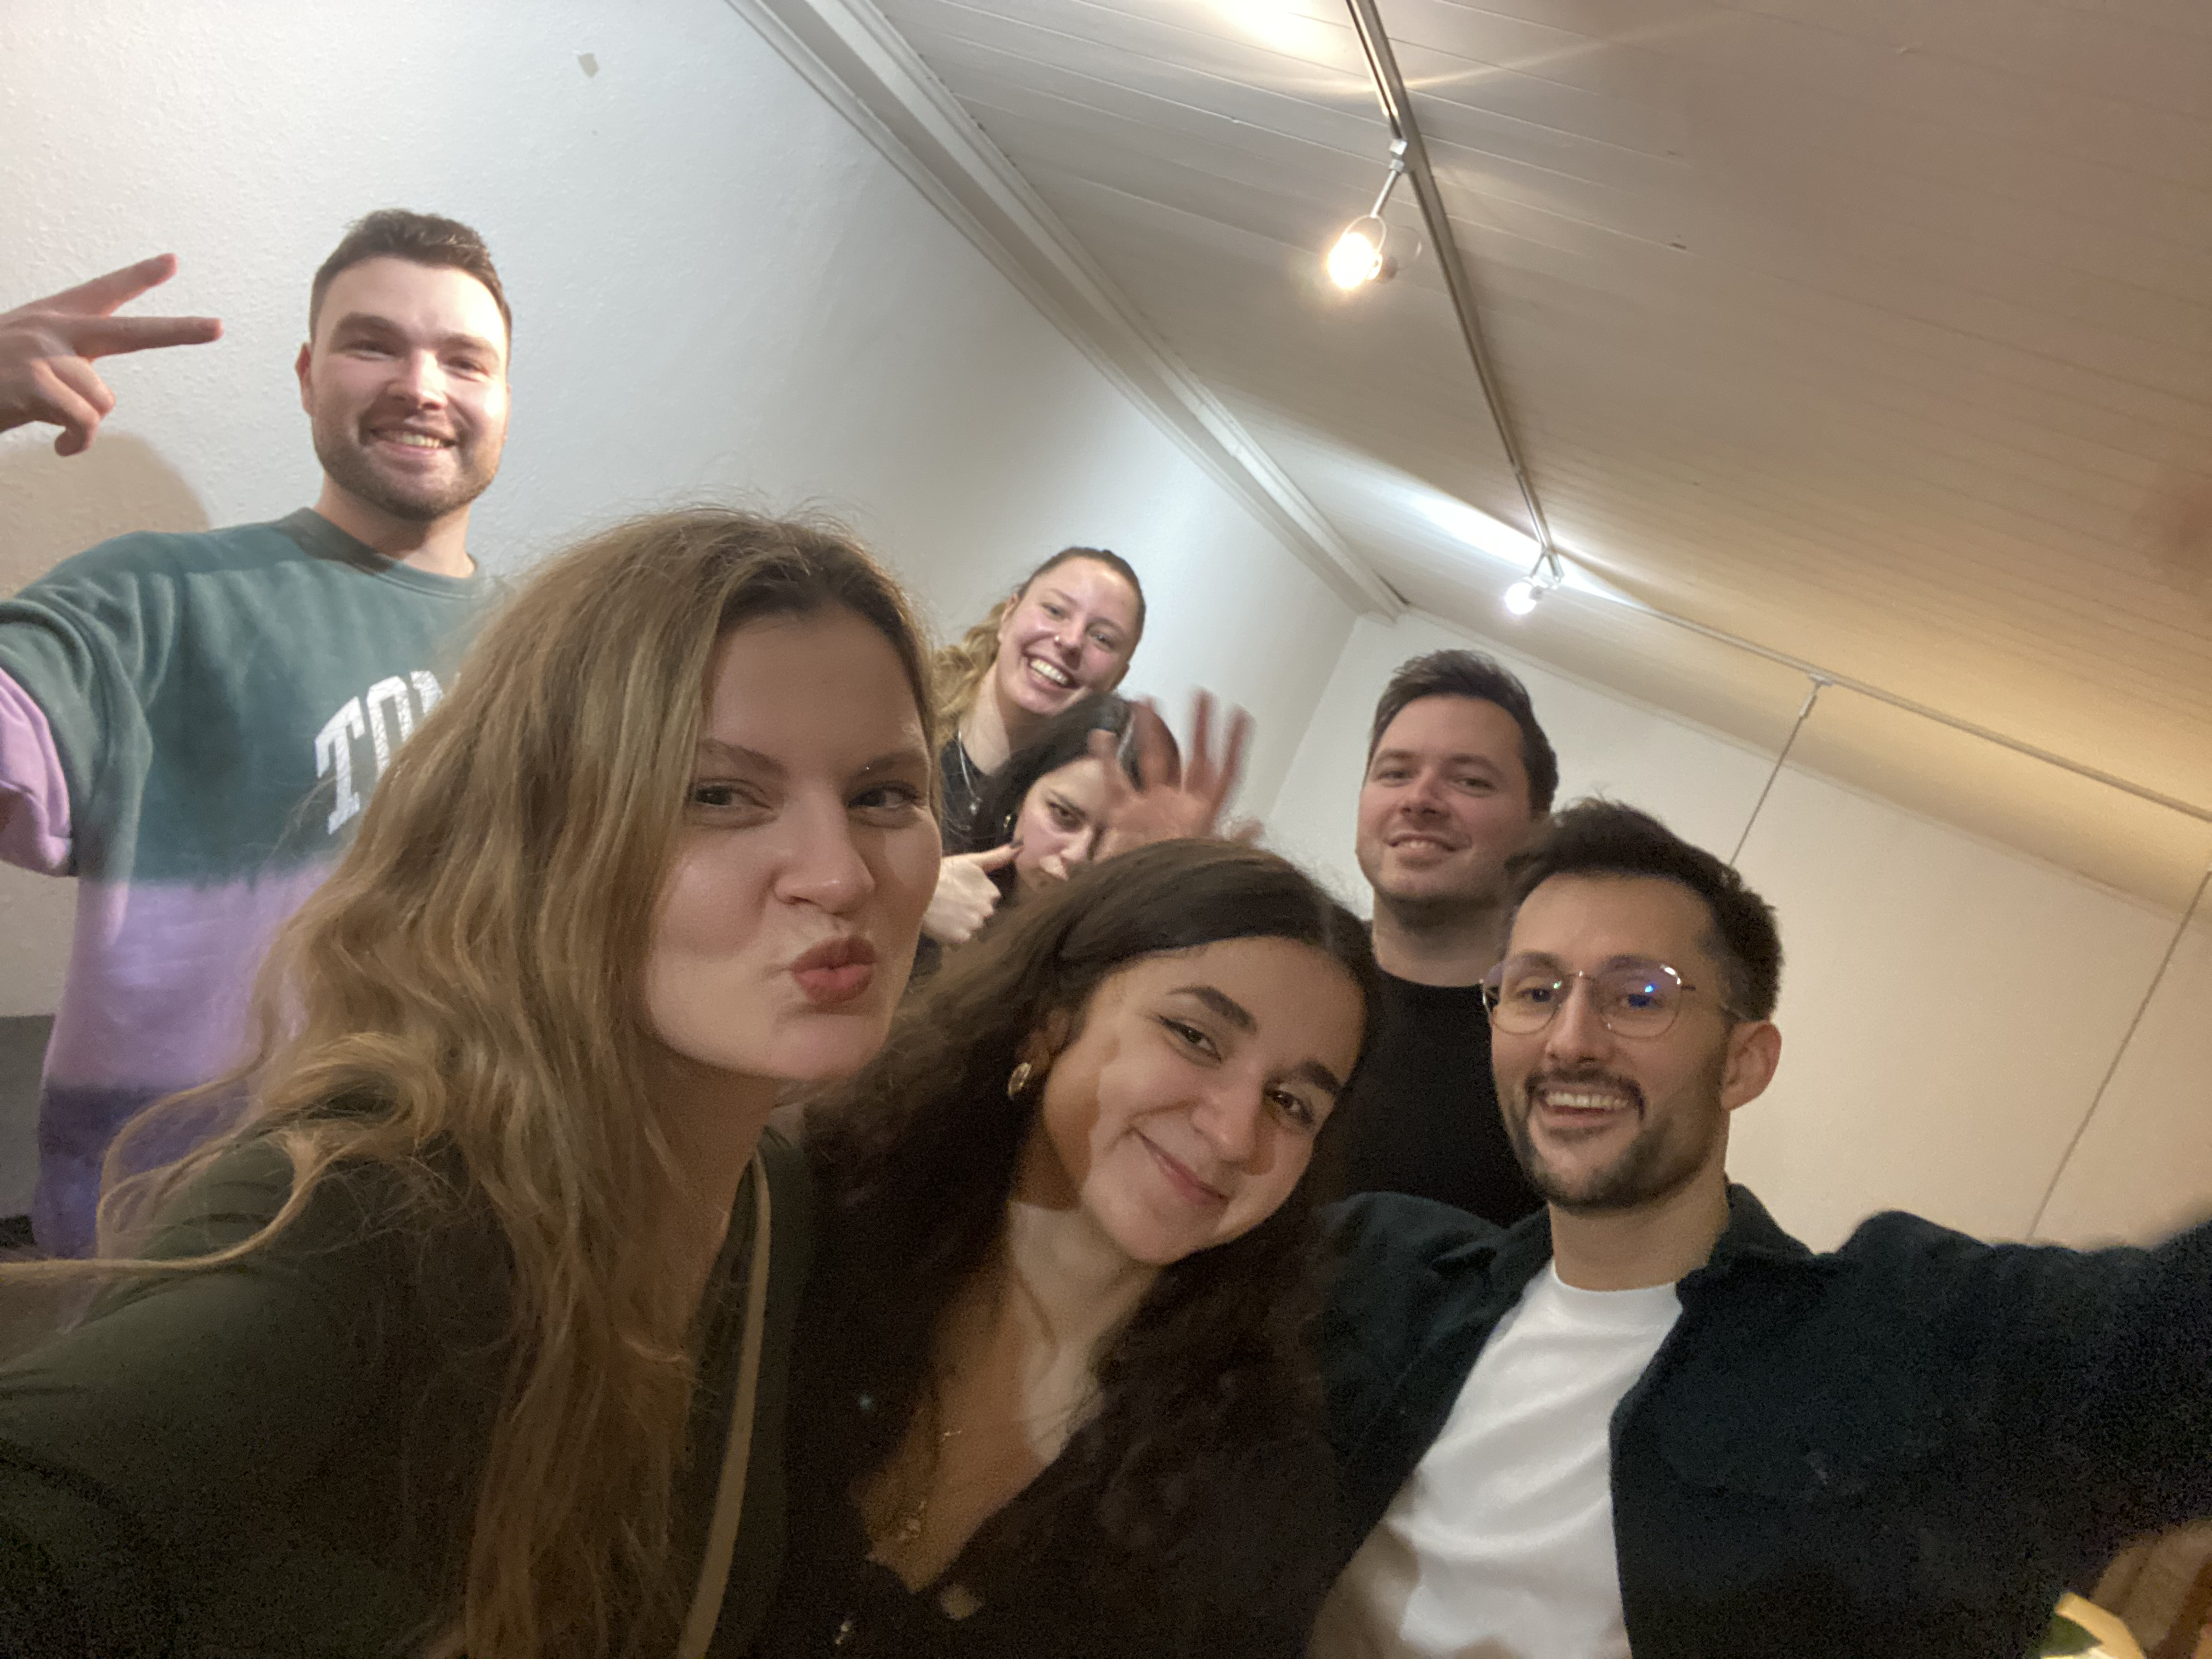
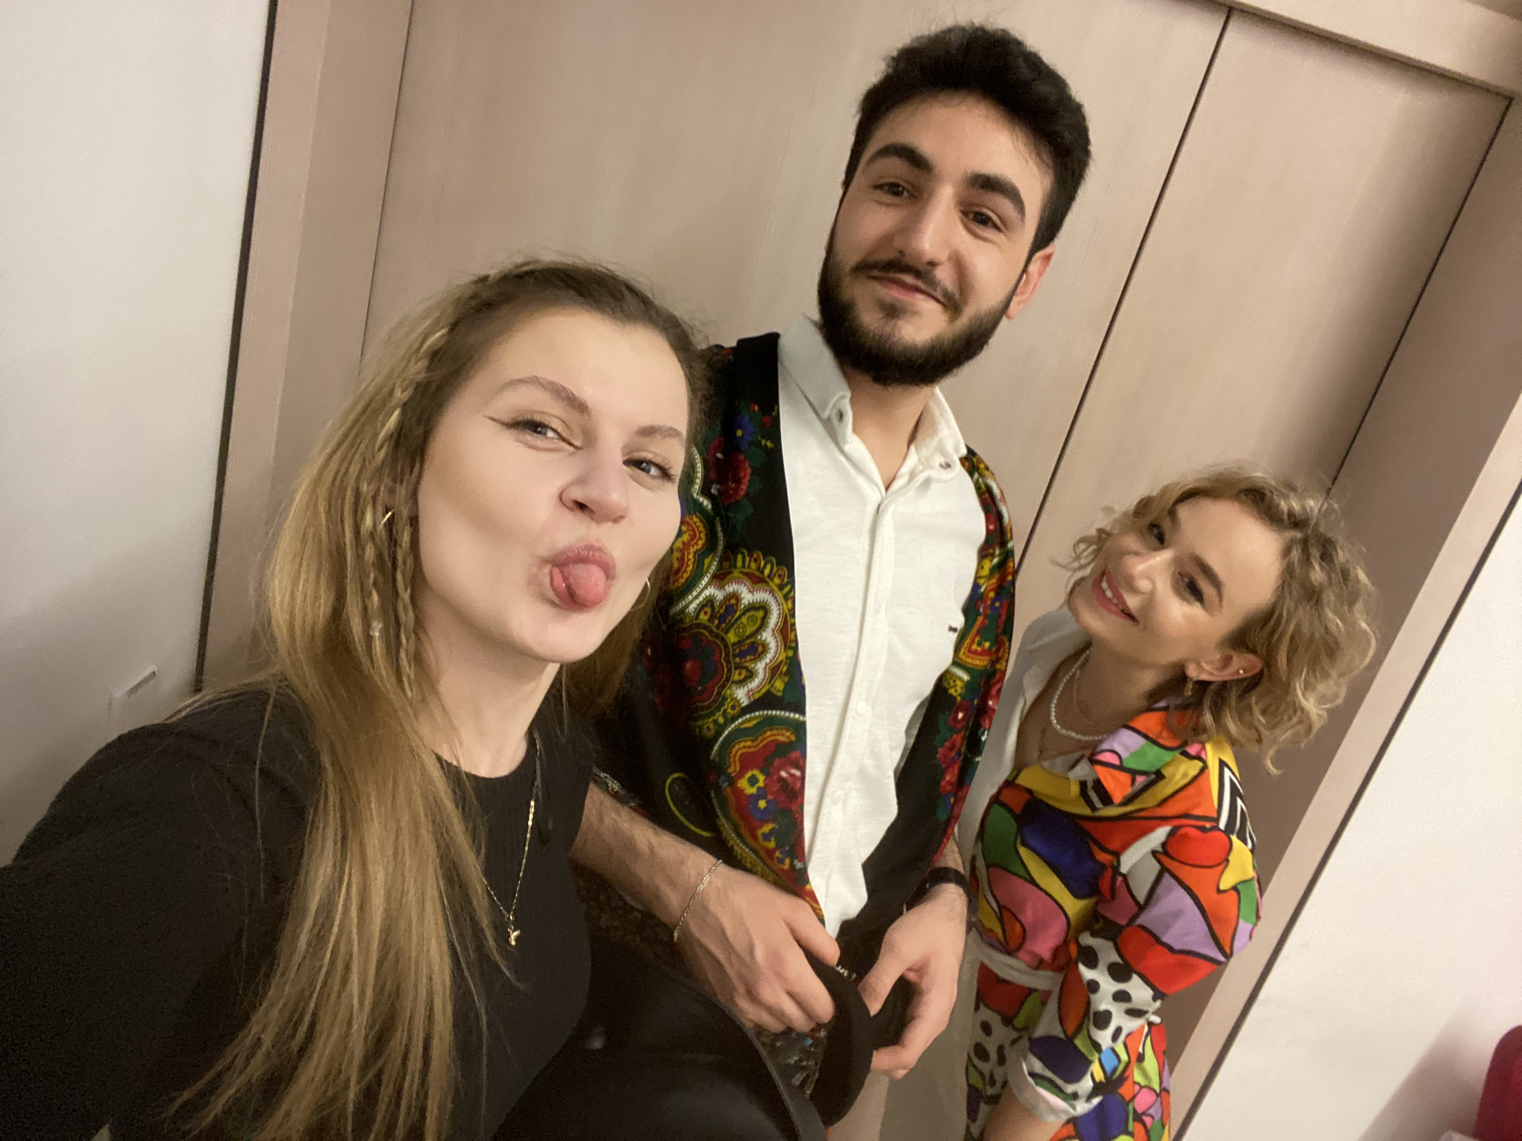
HANNOVER - people
We met many wonderful people from: Syria, Kurdistan, Canada, Ukraine, Russia, Colombia, Spain, Estonia, Korea, Lithuania, etc.

Slide 5
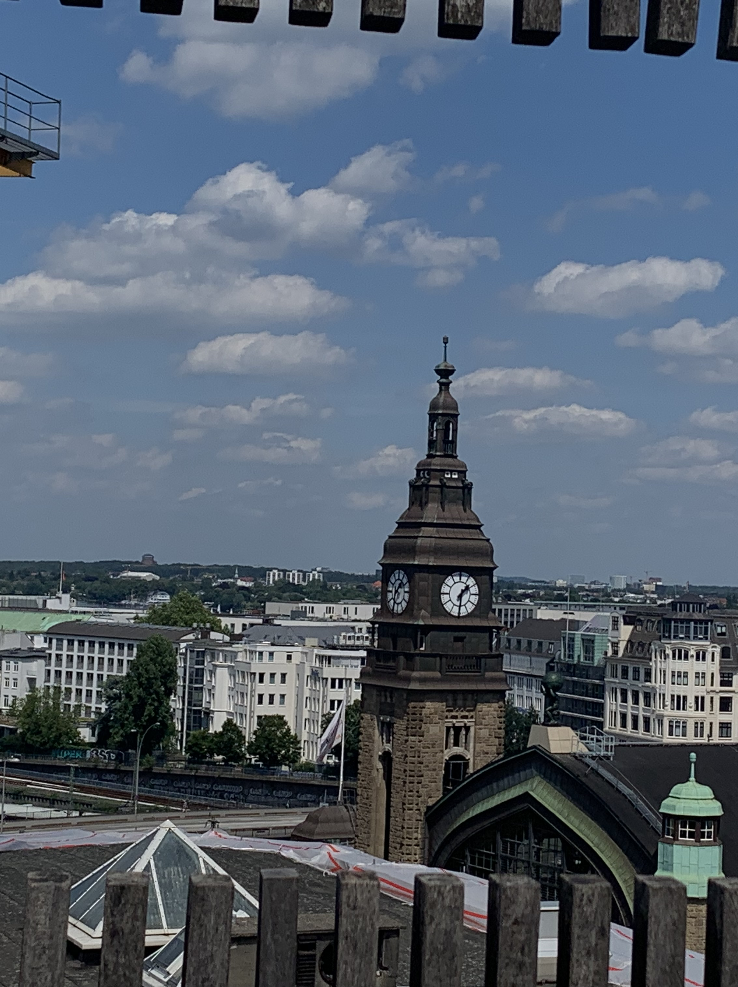
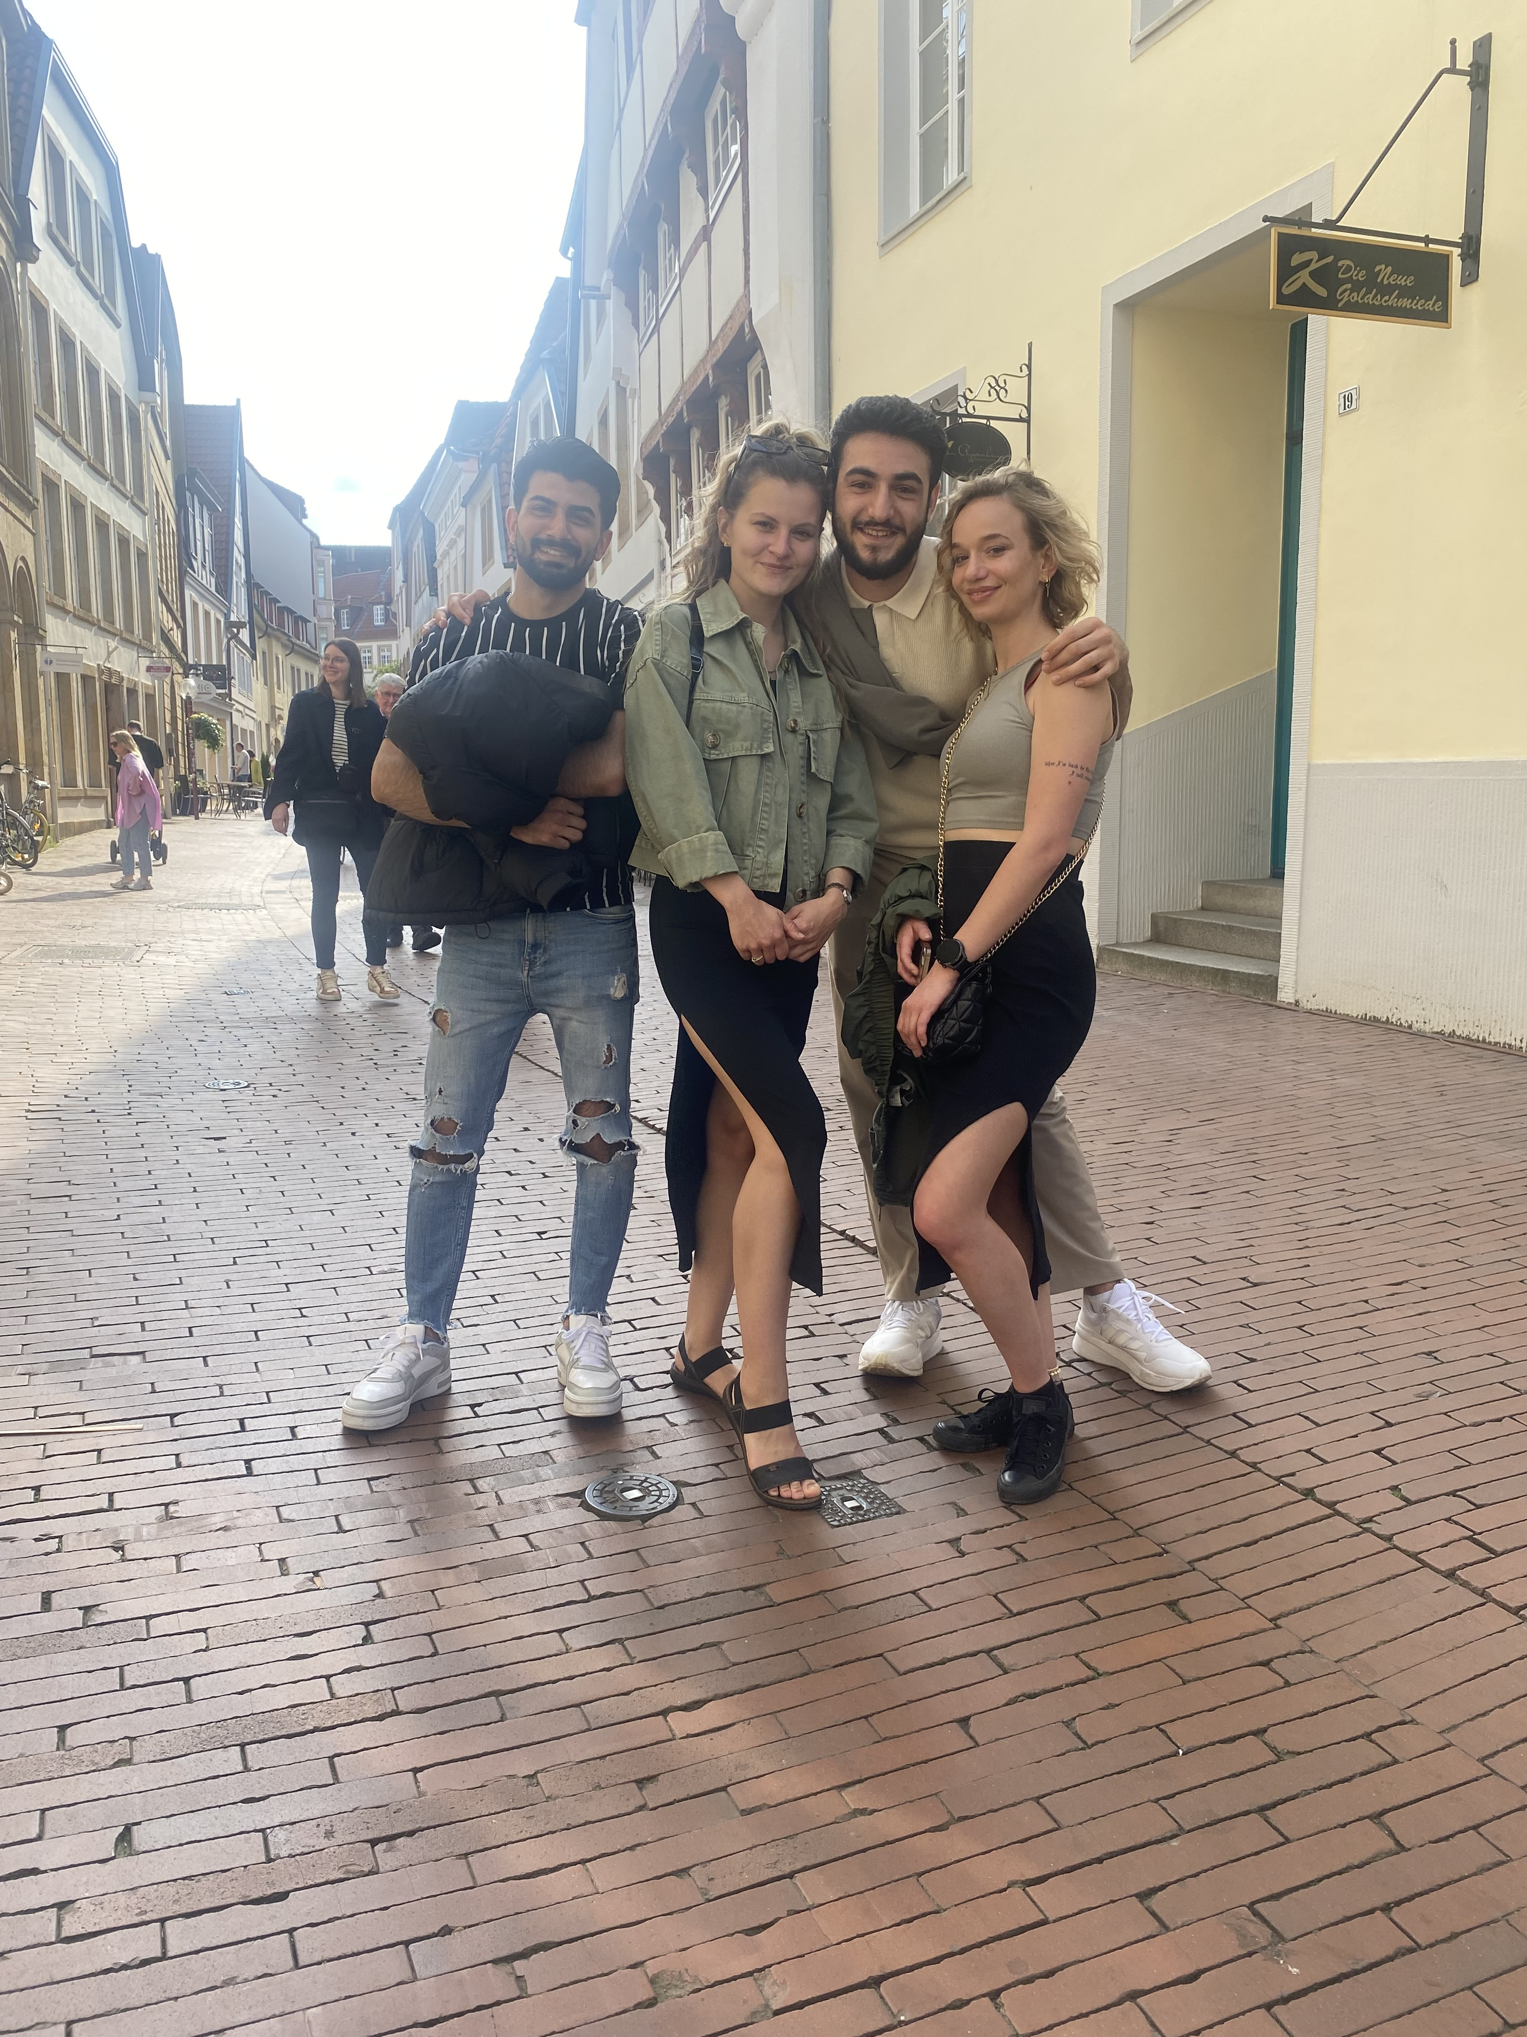
HAMBURG, BREMEN, OSNABRUCK
There are beautiful towns all around Hanover. Larger cities such as Bremen are an hour away from Hannover and Hamburg is two hours away.

Slide 6
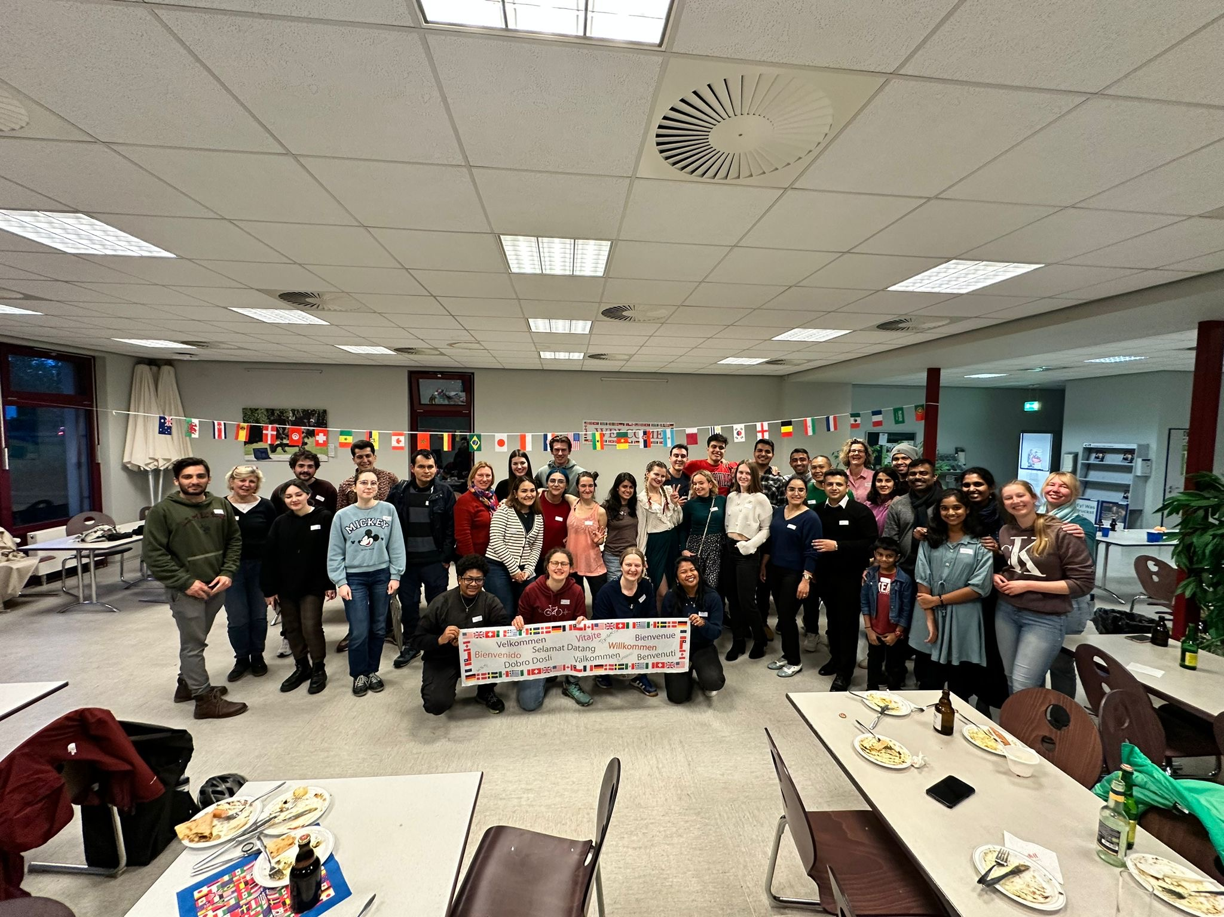
VIELEN DANK HANNOVER

