Slide 1
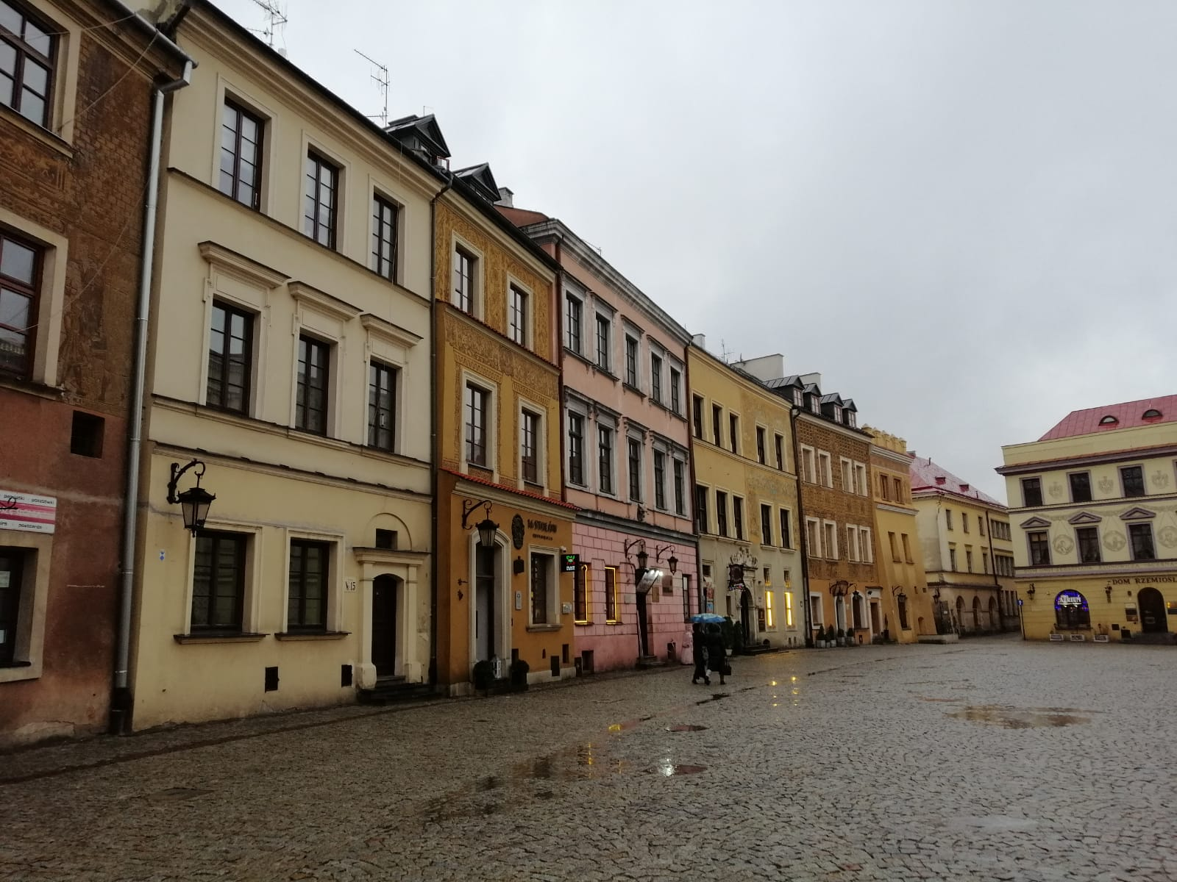
MY ERASMUS EXPERIENCE IN LUBLIN,POLAND

Slide 2
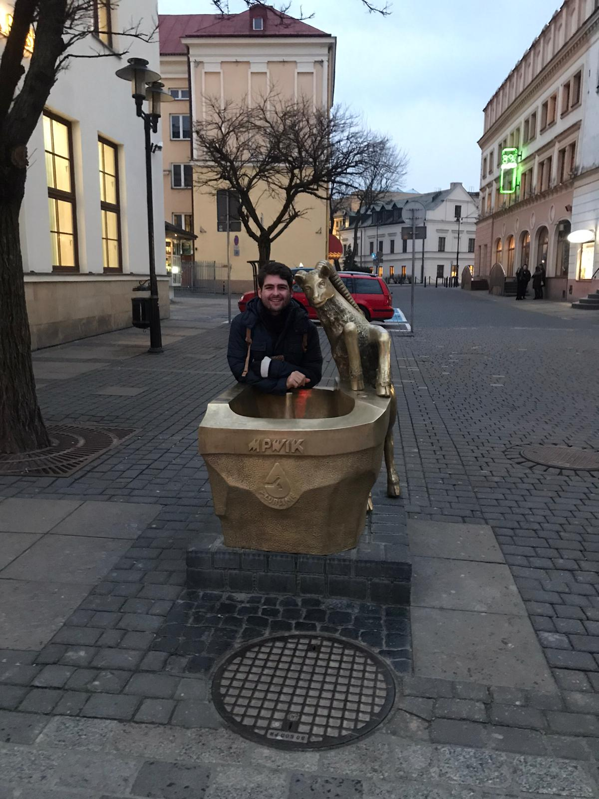
FIRST OF ALL I WOULD LIKE TO START BY INTRODUCING MYSELF. MY NAME IS BURAK INCEYER, I AM 23 YEARS OLD AND STUDYING VETERINARY MEDICINE. POLAND HAS ALWAYS BEEN ONE OF MY FAVOURITE COUNTRIES. ONE OF THE REASONS WHY I WANTED TO COME HERE AS AN ERASMUS STUDENT WAS THAT I HAVE BEEN TO THIS BEAUTIFUL COUNTRY BEFORE AND PARTICULARY LUBLIN. SO THIS TIME I WANTED TO EXPERIENCE BEING HERE MUCH BETTER BY BEING A STUDENT IN POLAND.IN SPITE OF THE PANDEMIC, I HAVE BEEN LUCKY ENOUGH TO DISCOVER THIS LOVELY COUNTRY, ITS PEOPLE, TRADITIONS AND ESPECIALLY FOOD. IN THIS PRESANTATION I AM TALKING ABOUT MY STAY IN LUBLIN AREA.

Slide 3
I HAVE BEEN IN LUBLUN FOR OVER 3 MONTHS. I ALWAYS DO SOME RESEARCH INTO WHERE I AM VISITING. BUT THIS TIME WAS DIFFERENT SINCE I HAVE ALWAYS LIKED POLAND AND POLISH HISTROY, SO LUBLIN WAS ONE OF THE RARE PLACES THAT I HADN’T DONE ANY RESEARCH BEFORE VISITING. BECAUSE I HAD ALREADY KNOWN ABOUT THIS FASCINATING CITY. AND I WOULD SAY I WAS KIND OF ONE OF THOSE LUCKY ONES TO BE ABLE TO SEE THIS CITY BEFORE THE 2020-2021 PANDEMIC.

Slide 4
DESPITE THIS PANDEMIC, I HAVE BEEN ABLE TO ENJOY THE CITY A LOT WITH ALL MY AMAZING FRIENDS THAT I MET HERE. THE OLD TOWN IS CERTAINLY ONE OF MY FAVOURITE CITIES. YOU CAN FEEL HISTORY ON EVERY CORNER. WHEN IT COMES TO FOOD WHICH IS MY FAVOURITE PART, CEBULARZ IS THE MOST FREQUENT ONE I EAT ALL THE TIME. BECAUSE OF THE FACT THAT YOU CAN FIND IT ON EVERY CORNER EASILY, IT HAS BECOME THE BAKED GOOD I HAVE EATEN MOST.

Slide 5
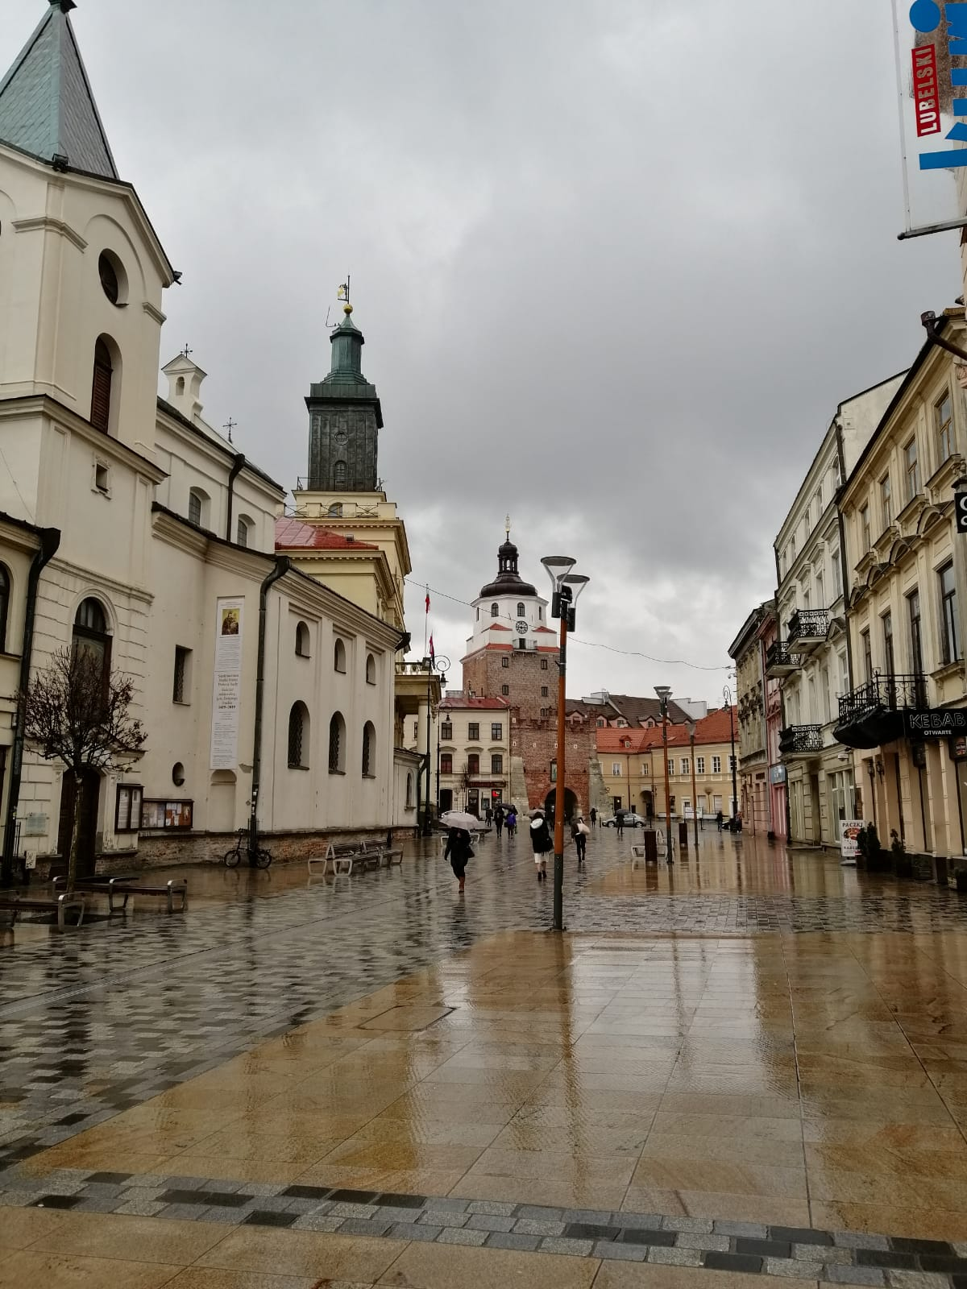
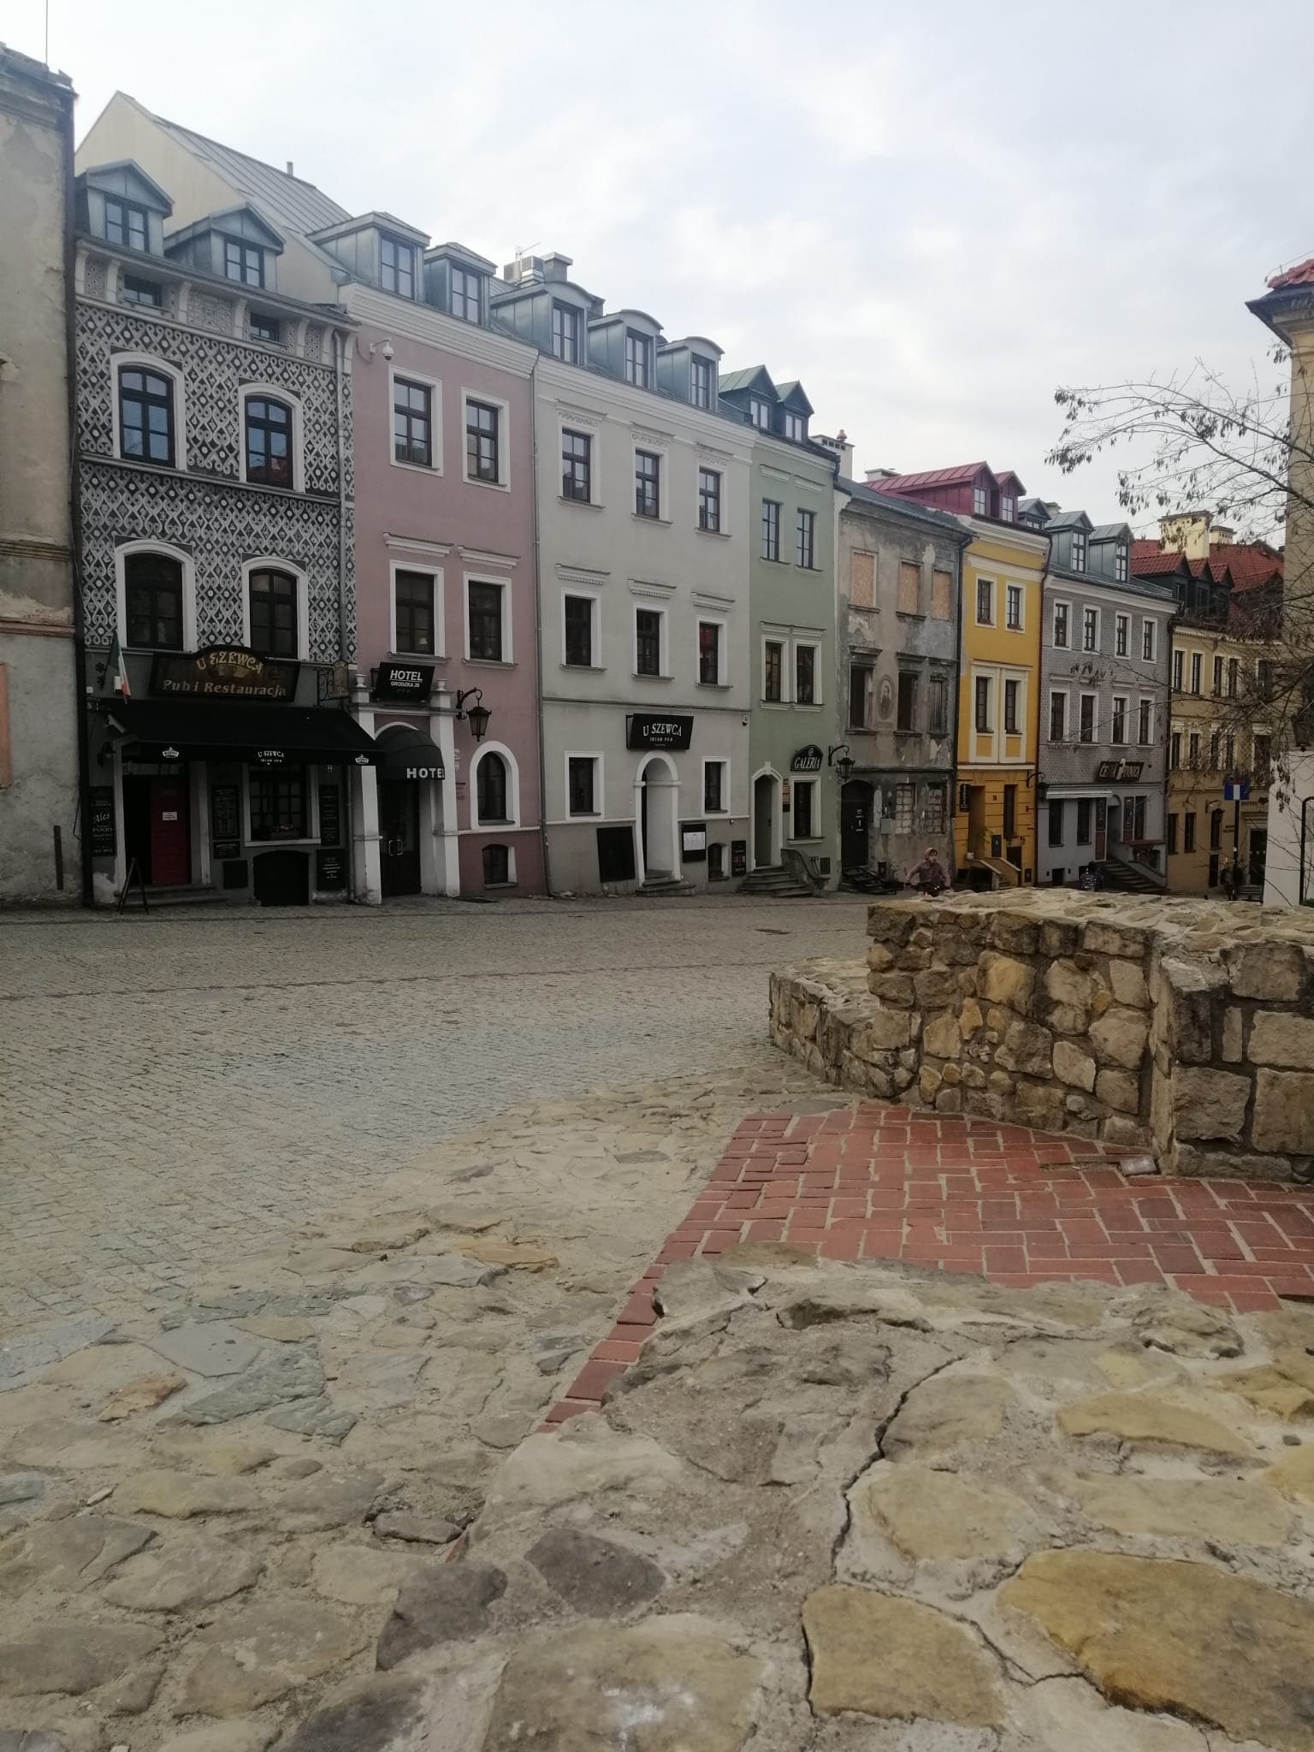

Slide 6
THE LUBLIN CASTLE IS BEYOND ALL DISPUTE FINEST HISTORICAL PLACE IN LUBLIN. WE CAN ALSO SEE THE CITY PANORAMA FROM ITS TOWER. THE MUSEUM IS ALSO SO EDUCATIONAL FOR THOSE WHO ARE INTO HISTORY. THE CASTLE IS BASICALLY SEEN FROM MANY POINTS IN THE OLD TOWN. SO I WOULD SAY THIS CASTLE AND ITS SURROUNDINGS ARE ONE OF MY FAVOURITE PLACES TO VISIT IN LUBLIN.

Slide 7
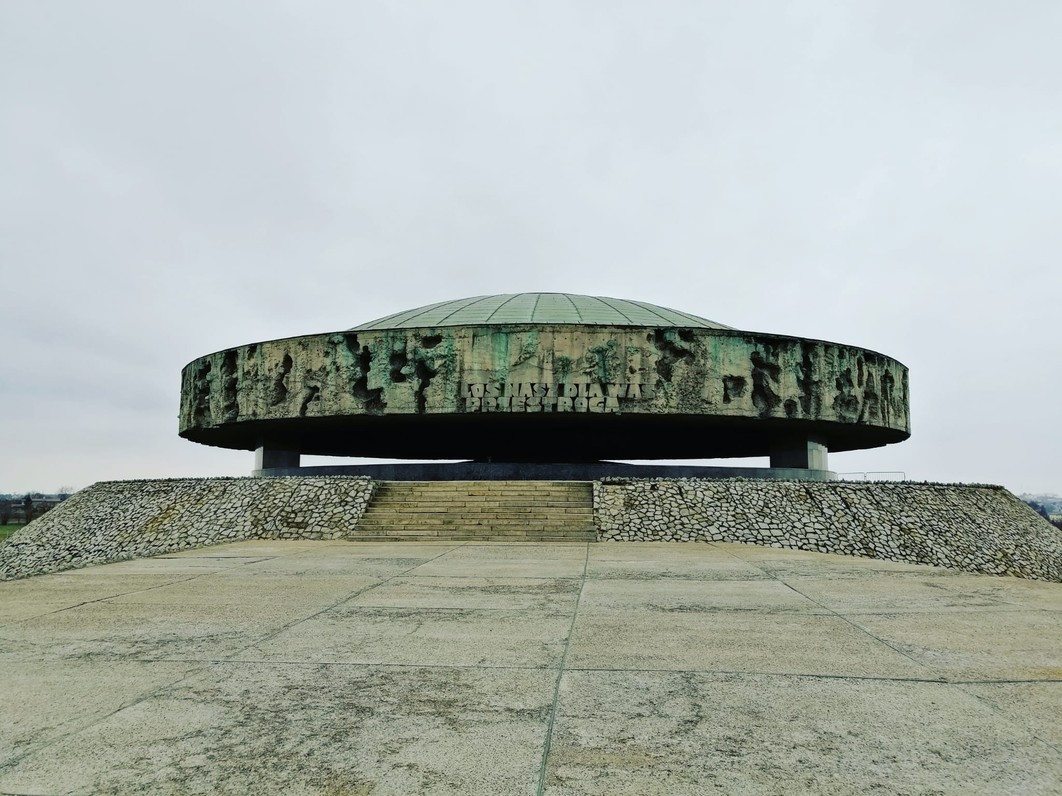
MAJDANEK
-majdanek was a nazı concentratıon and extermınatıon camp buılt and operated by the ss.
-Gıven the fact that ı have been studyıng the holocaust for 9 years, majdanek has become the most ımportant place for me throughout my stay ın lublın

Slide 8
-SO MAJDANEK HAS ULTIMATELY BECOME THE PLACE THAT I HAVE VISITED MOST IN LUBLIN. -IN MY OPINION MAJDANEK IS A PLACE THAT SHOULD BE VISITED BY EVERYBODY TO SEE WHAT DISCRIMINATION CAN CAUSE AND MORE PLACES LIKE MAJDANEK SHOULD BE PROTECTED FOR THE NEXT GENERATIONS TO COME. -NEVER AGAIN-NEVER FORGET

Slide 9
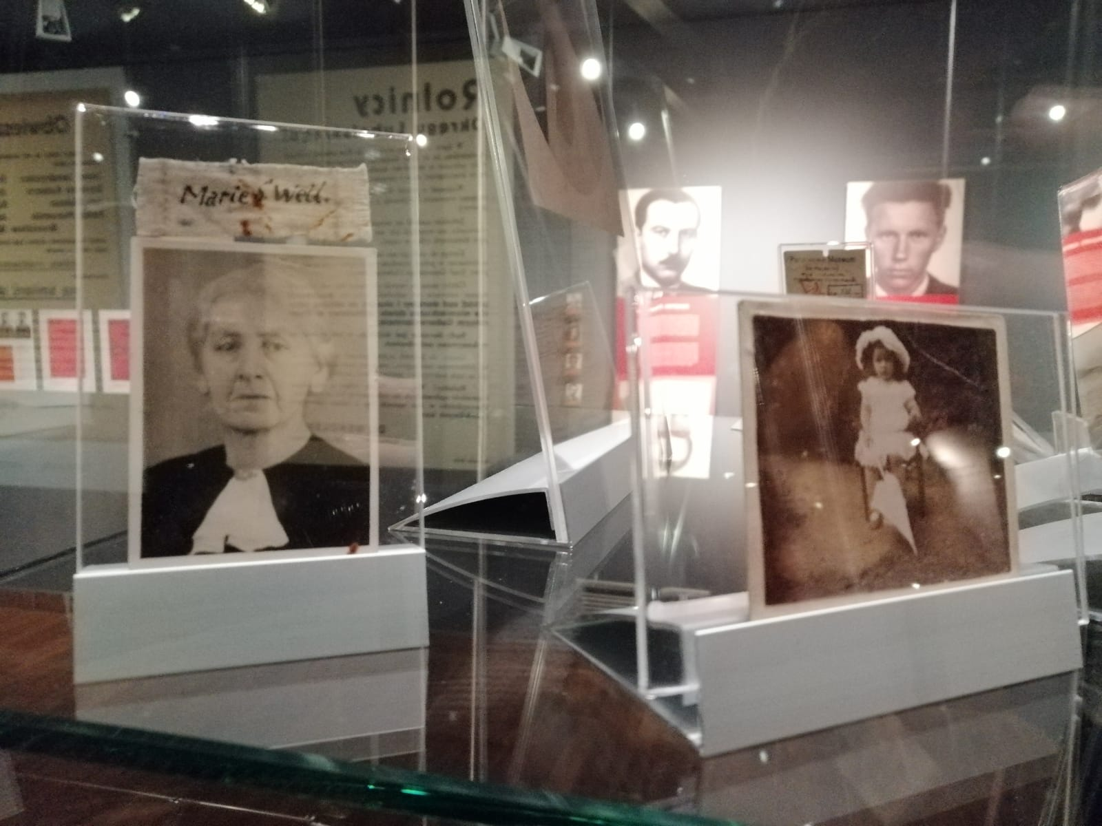
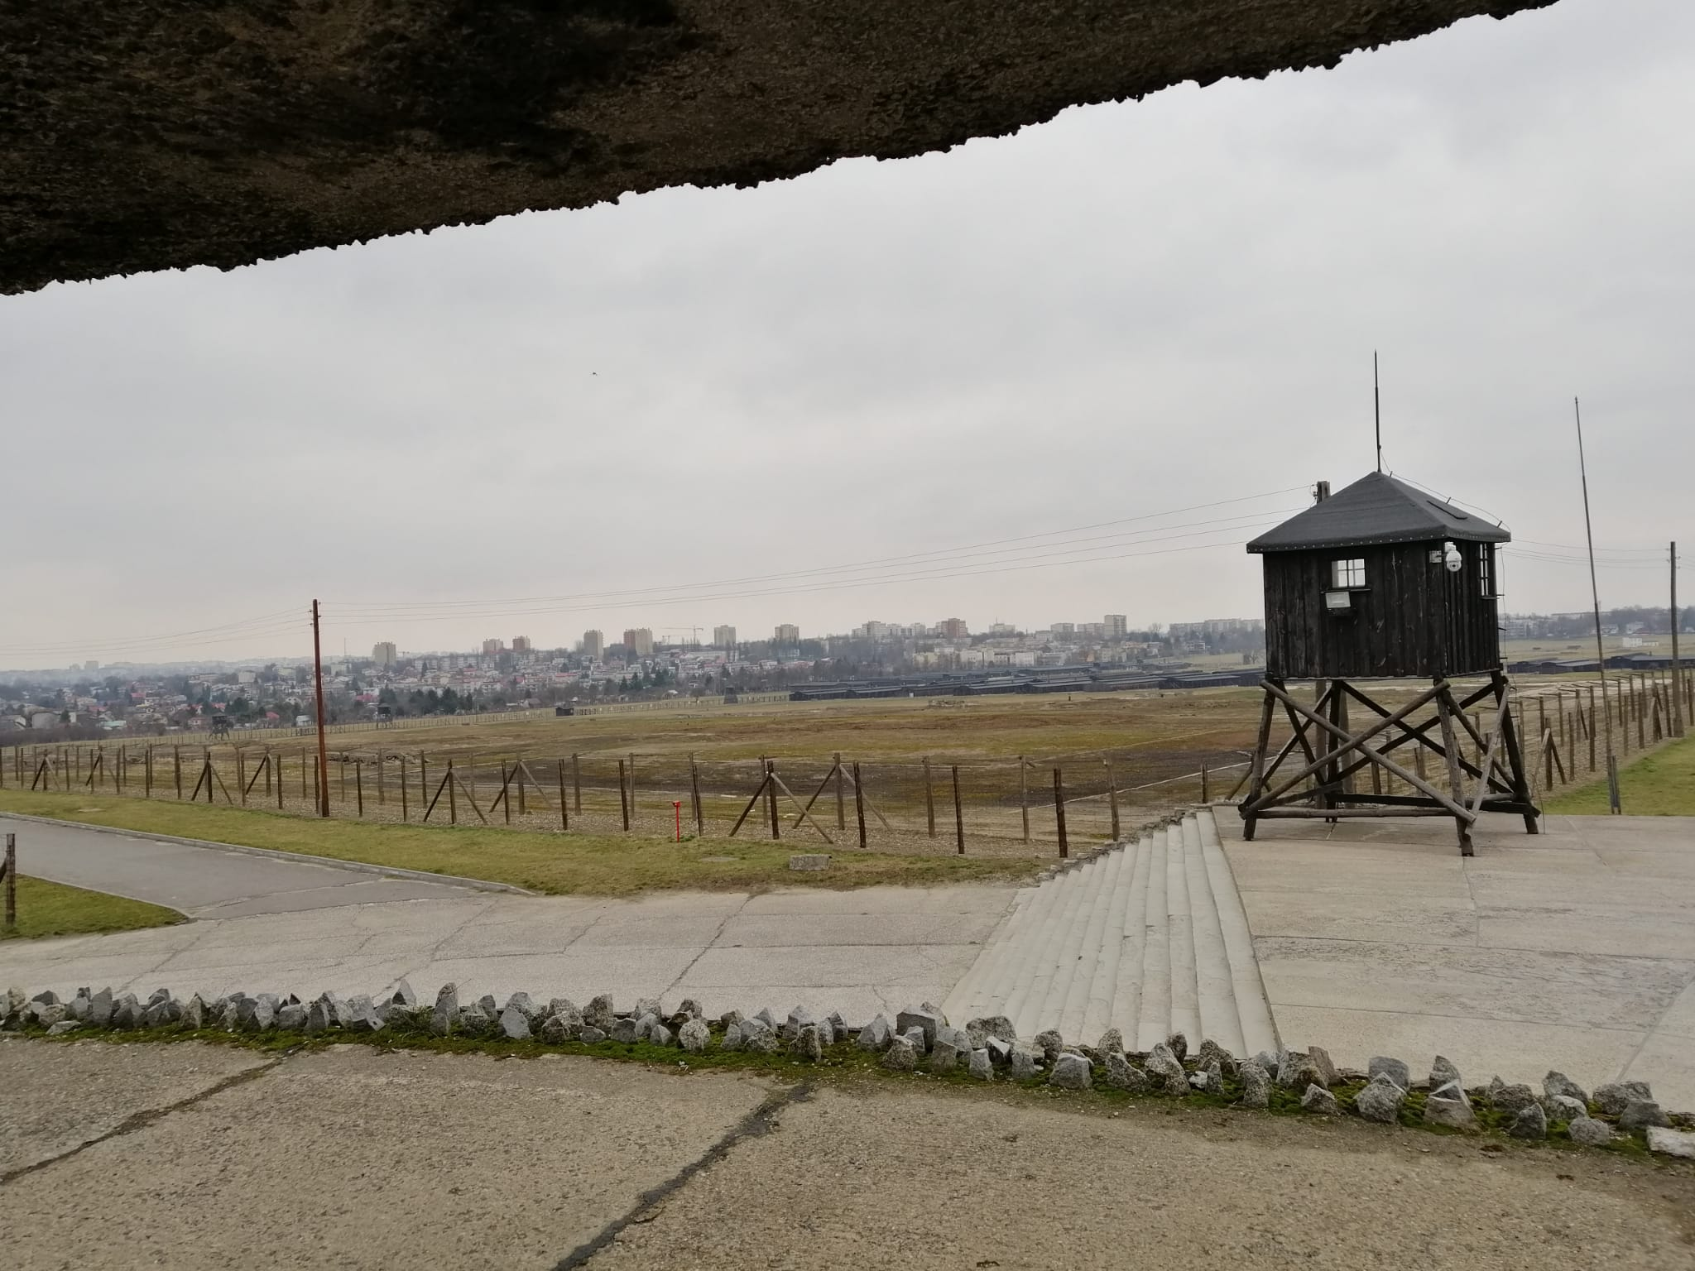

Slide 10
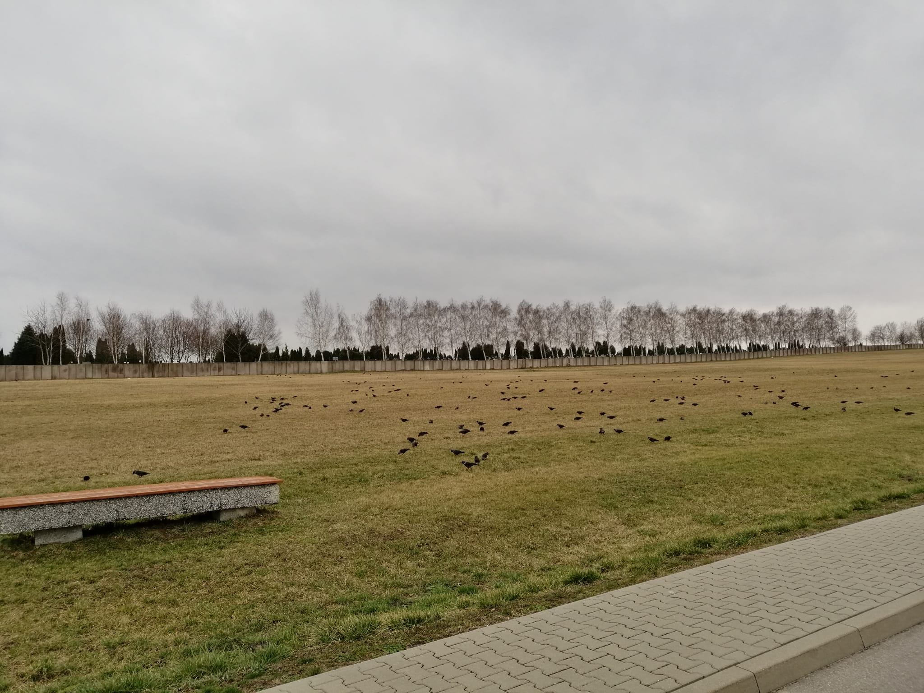

Slide 11
